Slide 2
25mx2.55m STRUCTURAL GLASS CANOPY
A. Mateo Marcos ENAR SLP. Architectural Envelopes

Slide 3
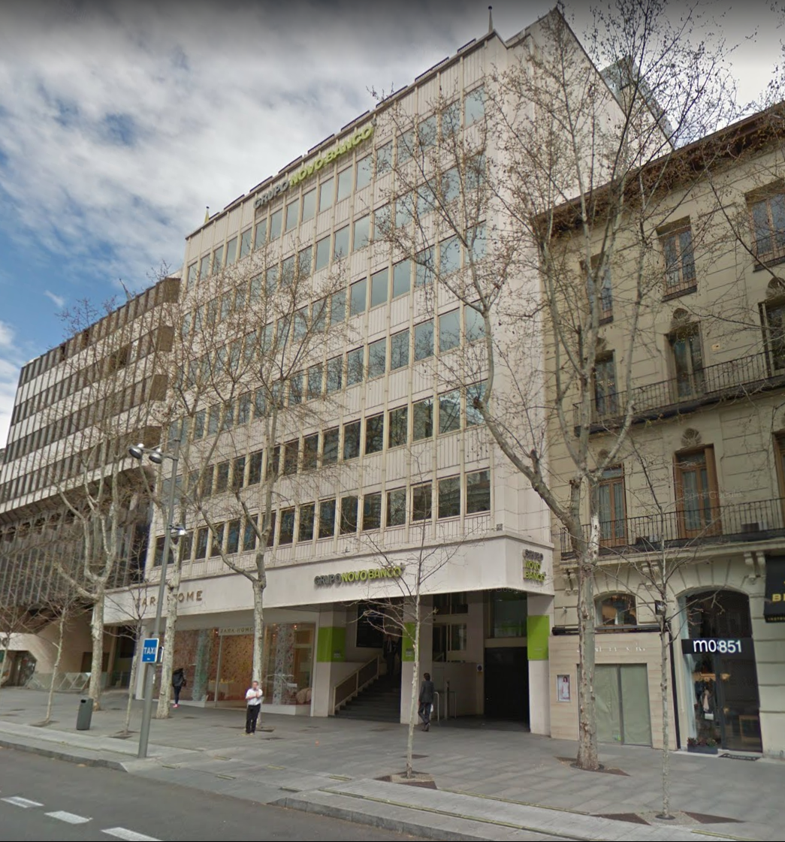
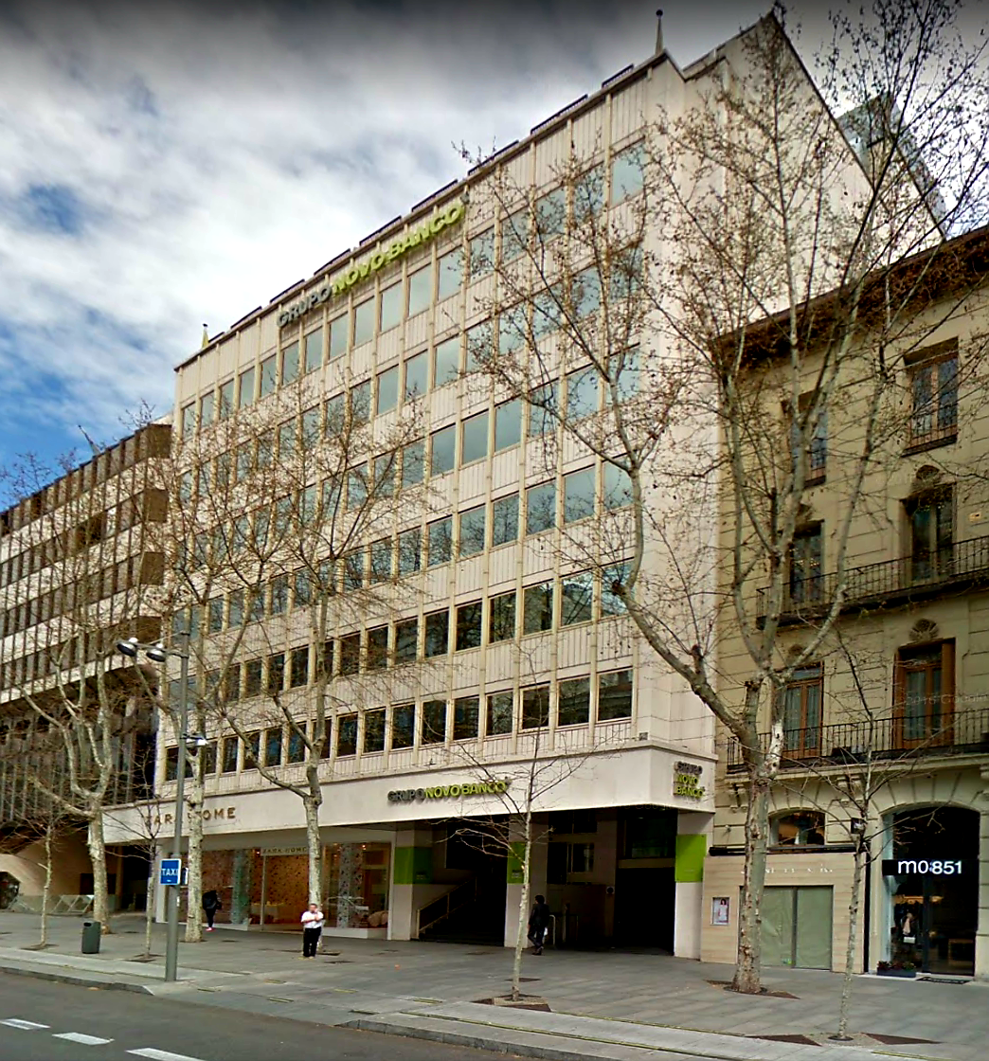
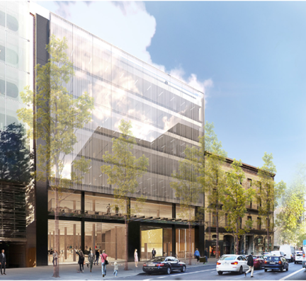
Notes:
This intervention in an existing office building aims to blur the limits between interior and exterior space, with a glass pavilion designed with curved geometries that merge with the garden creating a new fluid and hybrid landscape. The access to the building is transformed into a brand new experience in which interior and exterior melt together.

Slide 4
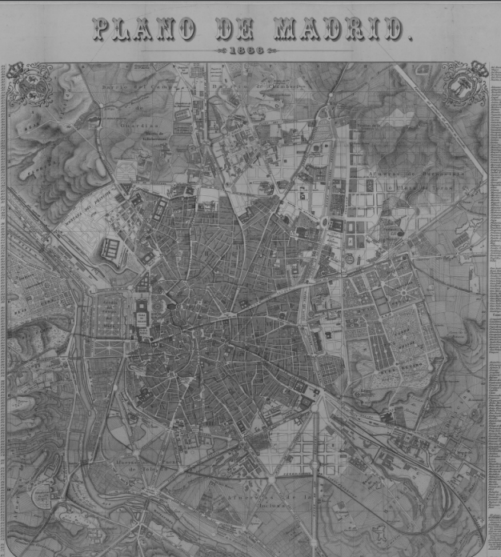
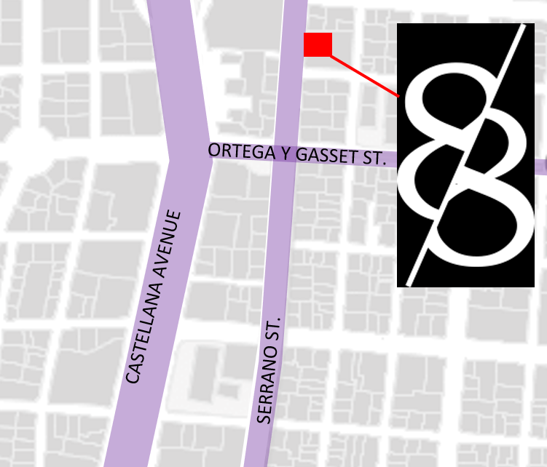
Notes:
This intervention in an existing office building aims to blur the limits between interior and exterior space, with a glass pavilion designed with curved geometries that merge with the garden creating a new fluid and hybrid landscape. The access to the building is transformed into a brand new experience in which interior and exterior melt together.

Slide 5
Notes:
This intervention in an existing office building aims to blur the limits between interior and exterior space, with a glass pavilion designed with curved geometries that merge with the garden creating a new fluid and hybrid landscape. The access to the building is transformed into a brand new experience in which interior and exterior melt together.

Slide 6
Notes:
This intervention in an existing office building aims to blur the limits between interior and exterior space, with a glass pavilion designed with curved geometries that merge with the garden creating a new fluid and hybrid landscape. The access to the building is transformed into a brand new experience in which interior and exterior melt together.

Slide 7
Notes:
This intervention in an existing office building aims to blur the limits between interior and exterior space, with a glass pavilion designed with curved geometries that merge with the garden creating a new fluid and hybrid landscape. The access to the building is transformed into a brand new experience in which interior and exterior melt together.

Slide 8
Notes:
The proposal was the winning entry in a restricted competition with a

Slide 9
Notes:
The proposal was the winning entry in a restricted competition with a

Slide 10
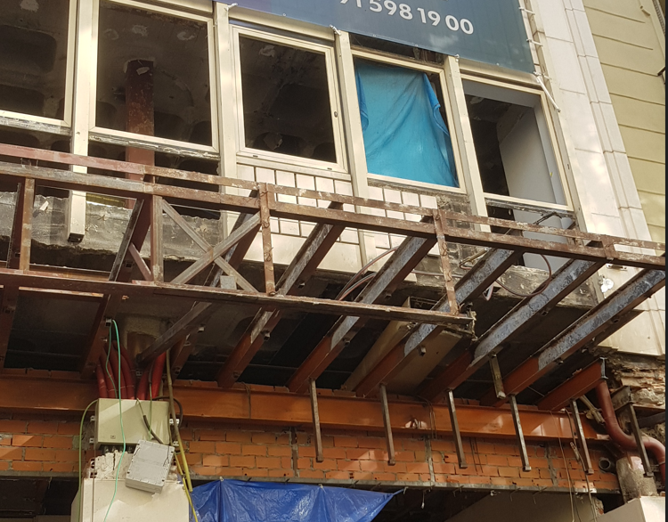
Notes:
The proposal was the winning entry in a restricted competition with a

Slide 11
Notes:
The proposal was the winning entry in a restricted competition with a

Slide 12
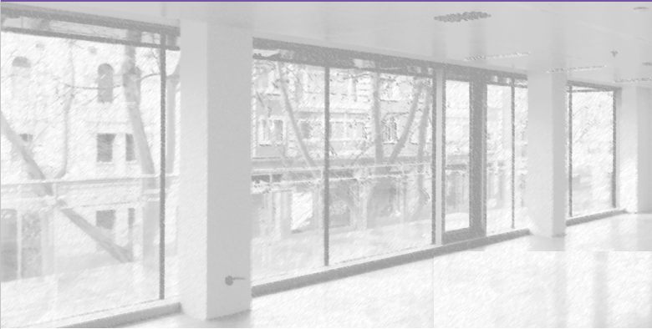
Notes:
The proposal was the winning entry in a restricted competition with a

Slide 13
Notes:
The proposal was the winning entry in a restricted competition with a

Slide 14
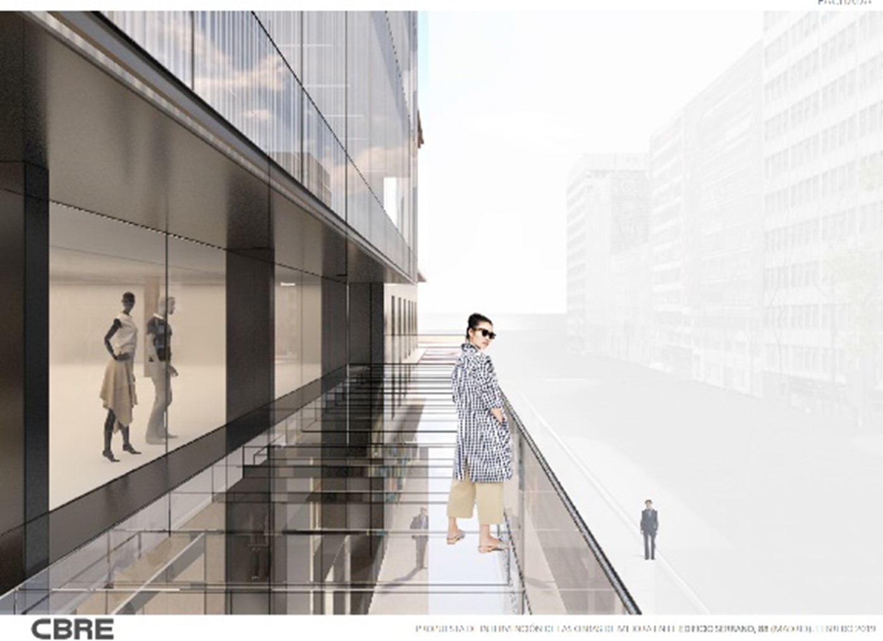
Notes:
The proposal was the winning entry in a restricted competition with a

Slide 15
Notes:
The proposal was the winning entry in a restricted competition with a

Slide 16
1,10m
Notes:
The proposal was the winning entry in a restricted competition with a

Slide 17
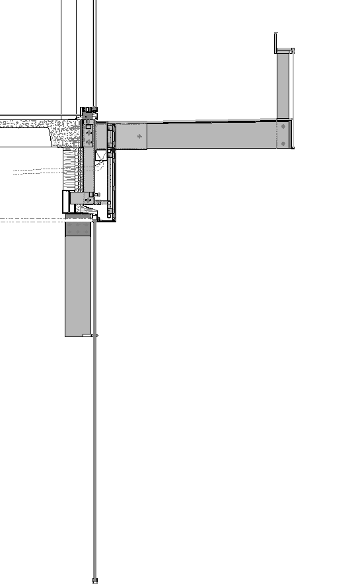
5,60m
Notes:
The proposal was the winning entry in a restricted competition with a

Slide 18
25m

Slide 19
25m
25m

Slide 20
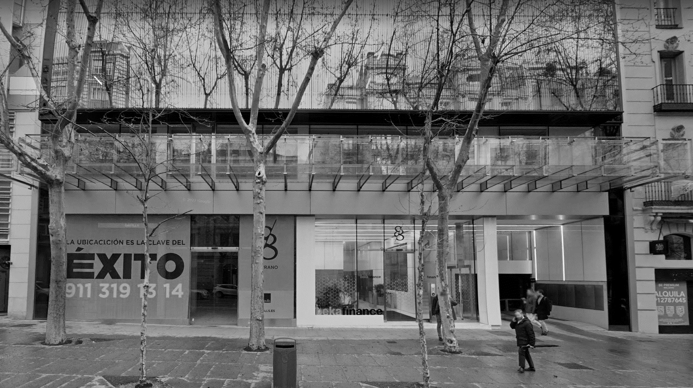
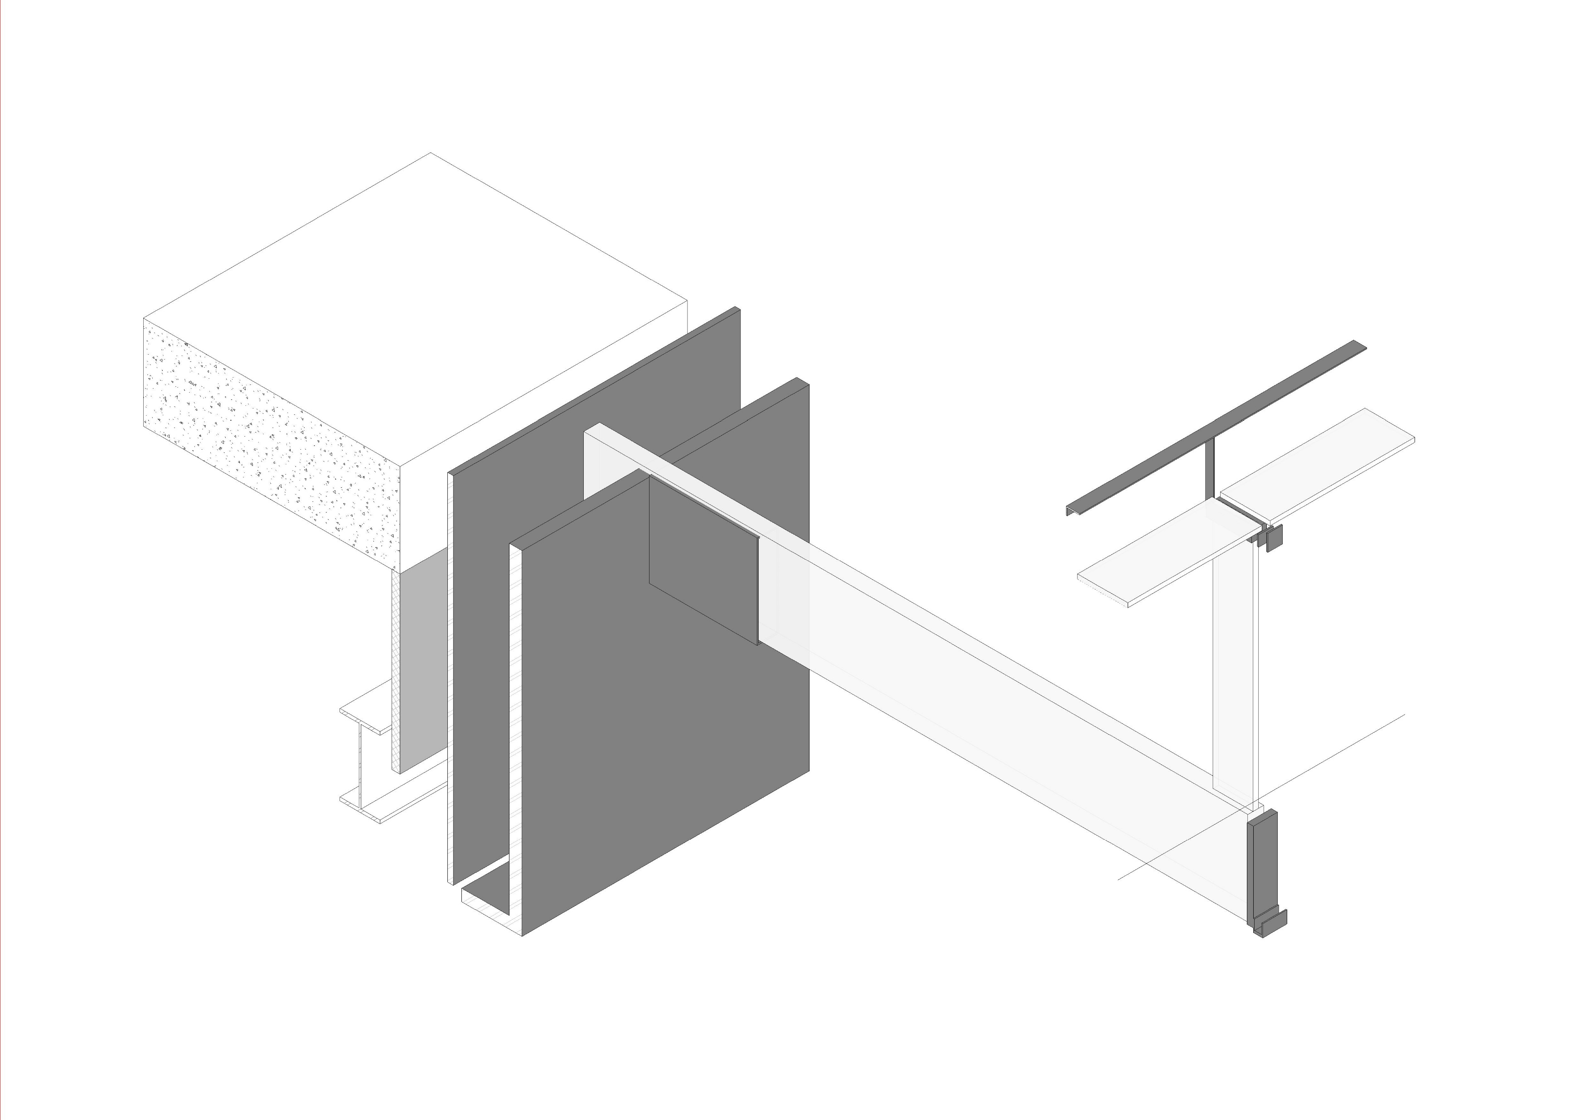
References and Structural criteria

Slide 21
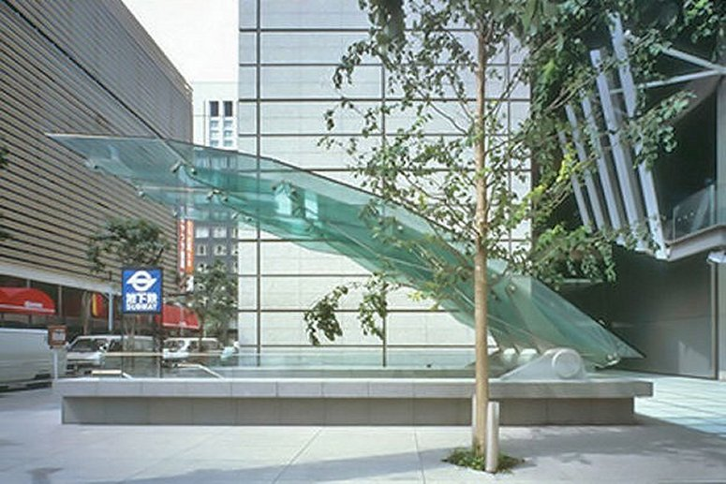
Yurakucho Canopy Tokyo, 1996
Rafael Vinoly Architects
Dewhurst MacFarlane and Partners

Slide 22
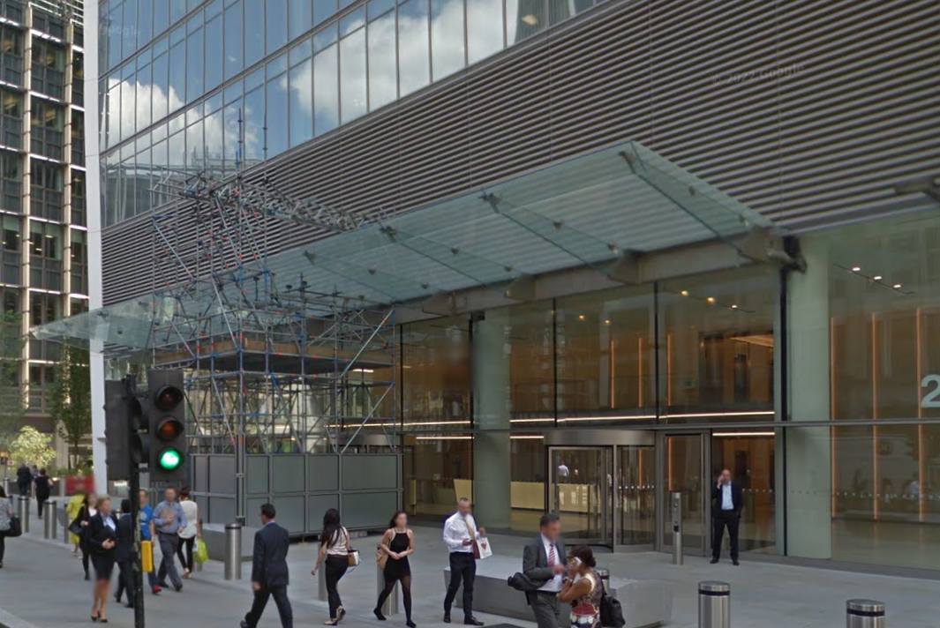
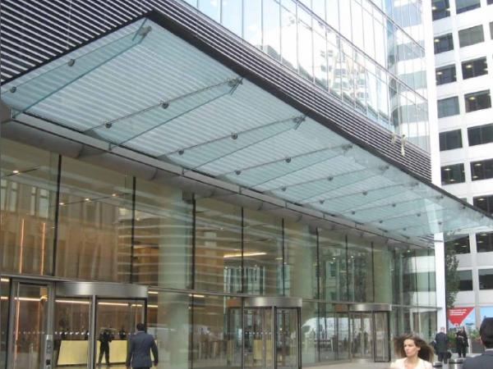
The Canopy - 20 Fenchurch Street in London. 2014
Rafael Vinoly Architects
Josef Gartner GmbH

Slide 23
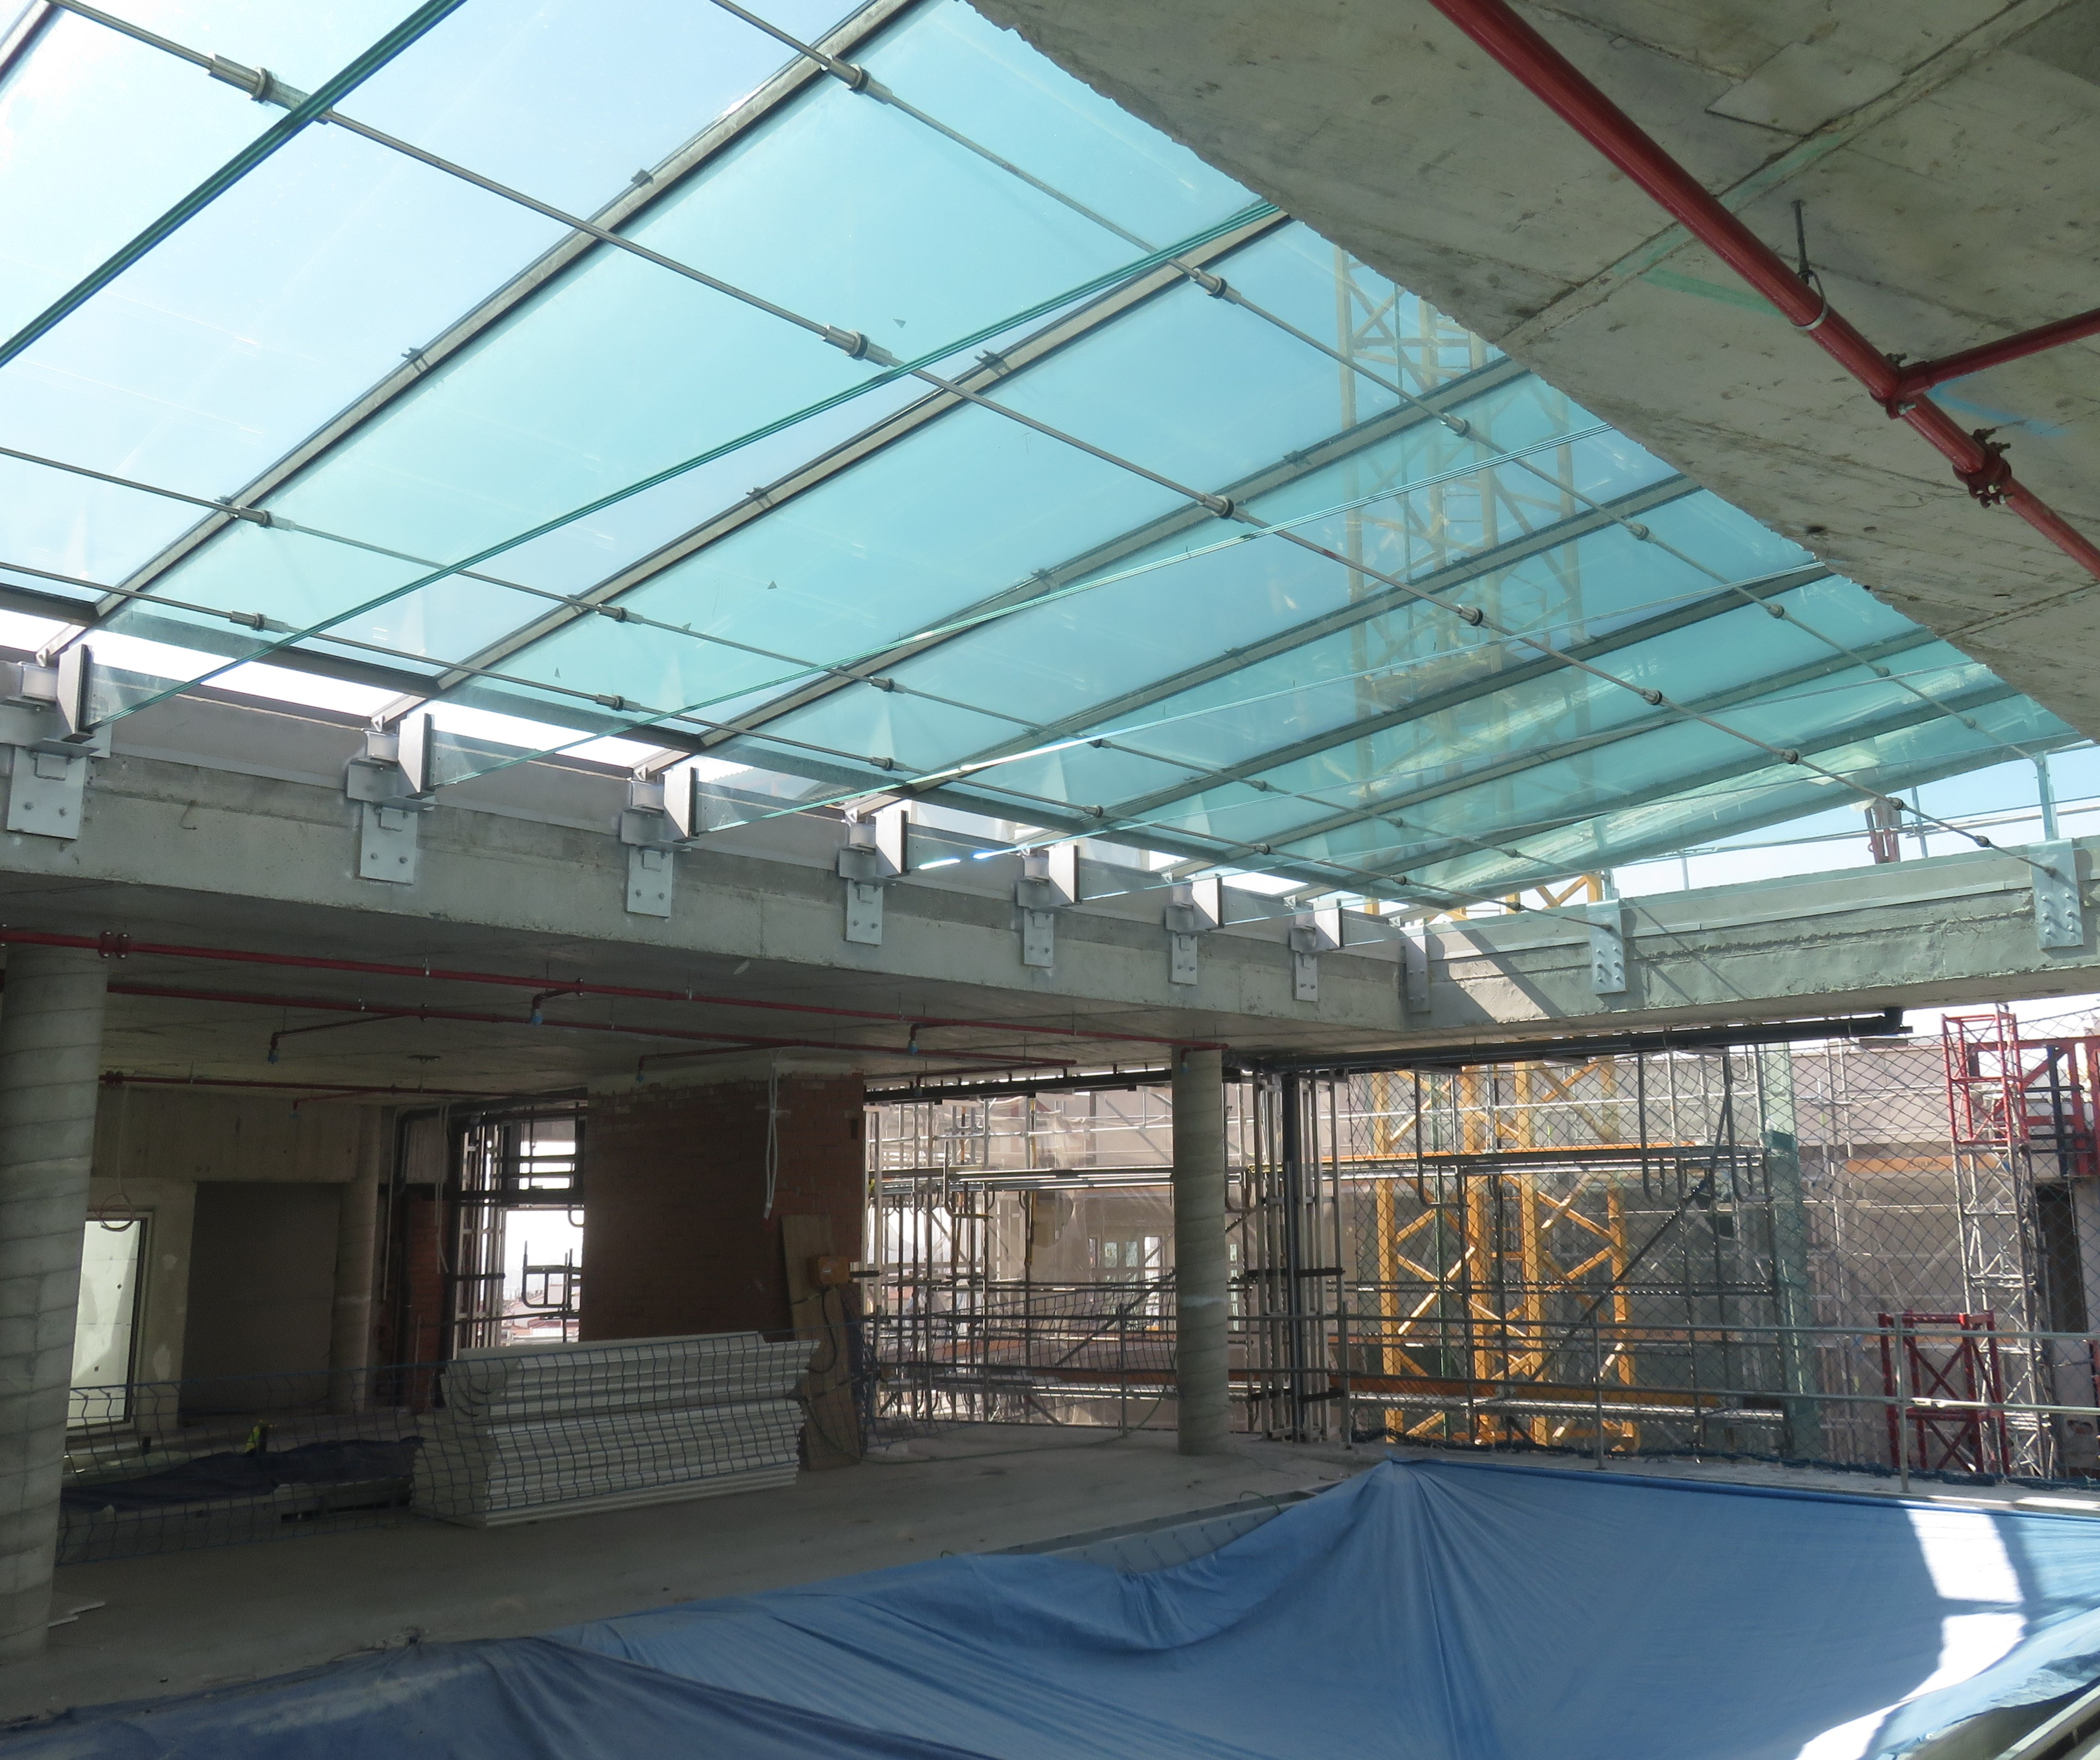
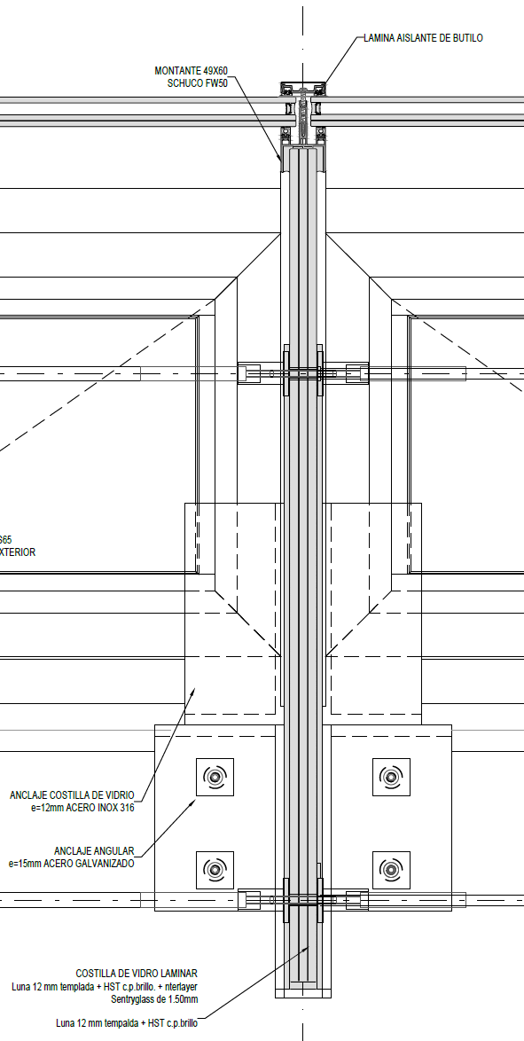
Canalejas Madrid Center Refurbishment. Madrid 2018
Estudio Lamela+ENAR SPL

Slide 24
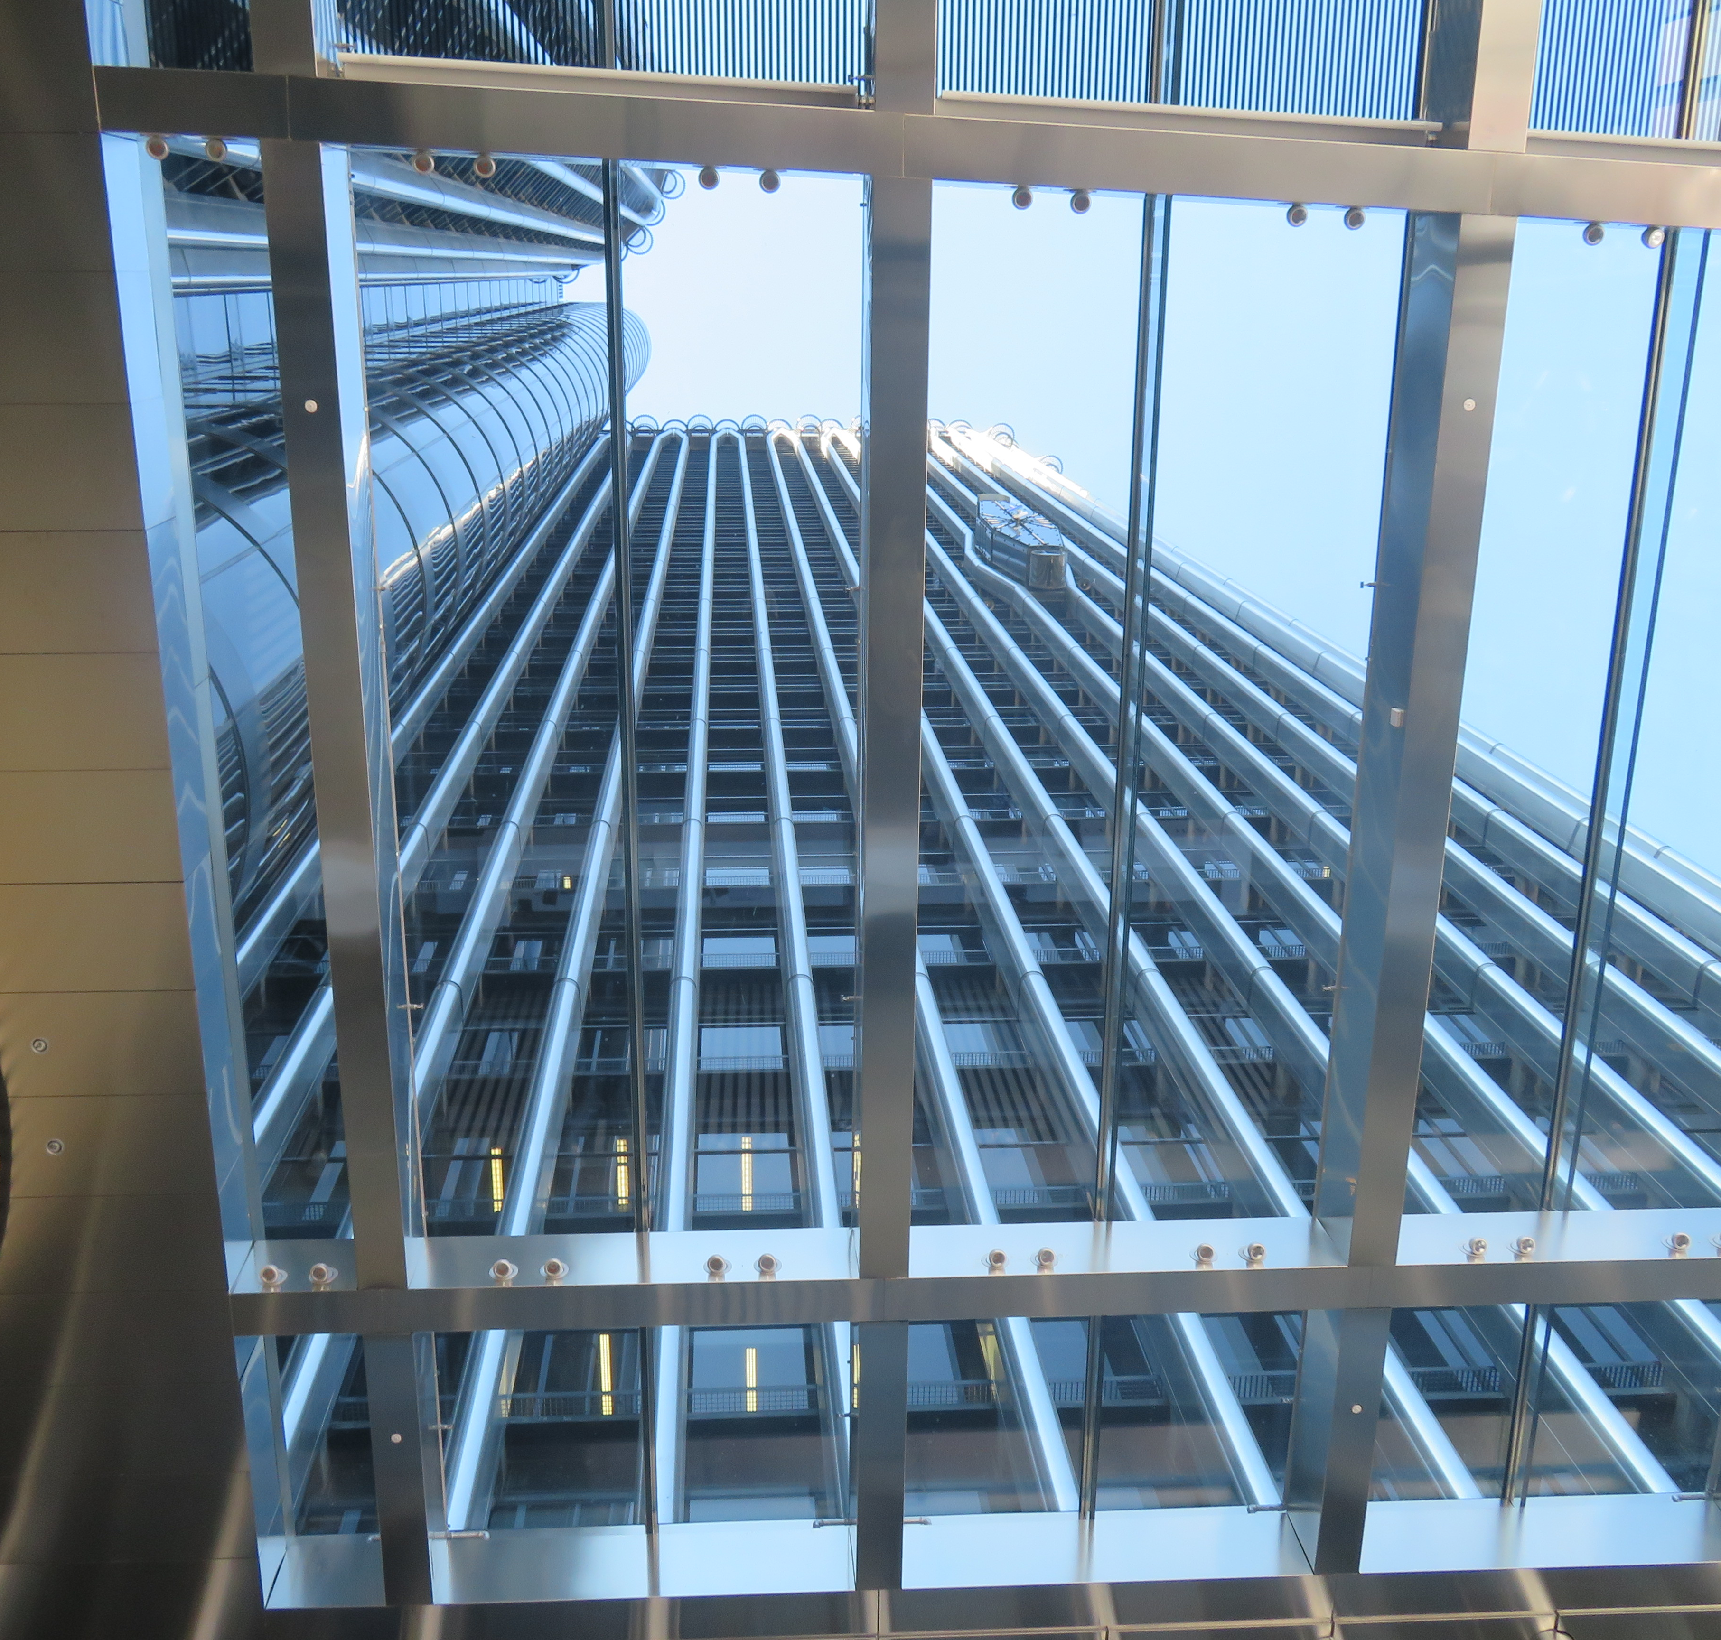
Torre Europa Office Refurbishment. Madrid 2017 CallisonRTKL+ ENAR SPL

Slide 25
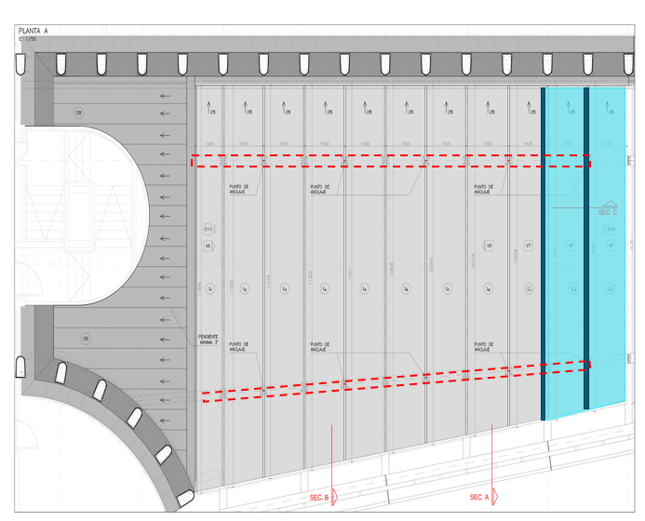
Torre Europa Office Refurbishment. Madrid 2017 CallisonRTKL+ ENAR SPL

Slide 27
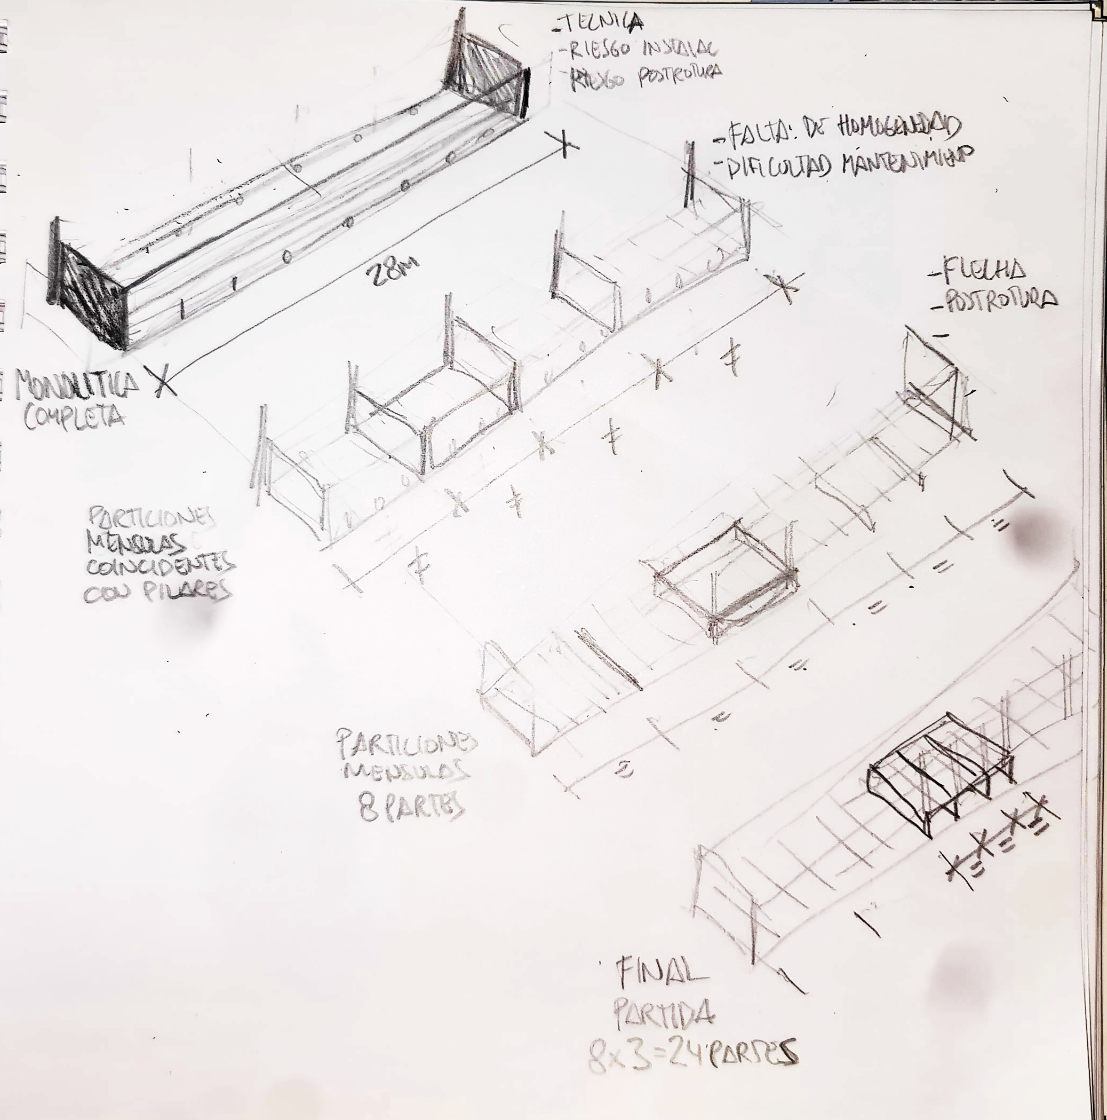
Option 1 Monolithic
 | OPTION 1
CANTILEVER | 2x high reactions
BARRIER | 25m structural assembled laminated glass
GLASS FLOOR | 2,5x6 (2 sides supported)

Slide 28
Option 2 Irregular (columns)
 | OPTION 1 | OPTION 2
CANTILEVER | 2x high reactions | 5x
BARRIER | 25m structural assembled laminated glass | 8m structural laminated glass
GLASS FLOOR | 2,5x6 (2 sides supported) | 2,5x6 (3 sides supported)

Slide 29
Option 3 Regular (cantilevers below of the glass floor)
 | OPTION 1 | OPTION 2 | OPTION 3
CANTILEVER | 2x high reactions | 5x | 9x
BARRIER | 25m structural assembled laminated glass | 8m structural laminated glass | 3,1 m structural laminated glass
GLASS FLOOR | 2,5x6 (2 sides supported) | 2,5x6 (3 sides supported) | 2,5x3,1 (4 sides supported)

Slide 30
Option 4 Regular (3x8 Cantilevers below of the glass floor)
 | OPTION 1 | OPTION 2 | OPTION 3 | OPTION 4
CANTILEVER | 2x high reactions | 5x | 9x | 25x
BARRIER | 25m structural assembled laminated glass | 8m structural laminated glass | 3,1 m structural laminated glass | 3,1 m non structural laminated glass
GLASS FLOOR | 2,5x6 (2 sides supported) | 2,5x6 (3 sides supported) | 2,5x3,1 (4 sides supported) | 2,5x1,034 (4 sides supported)

Slide 31
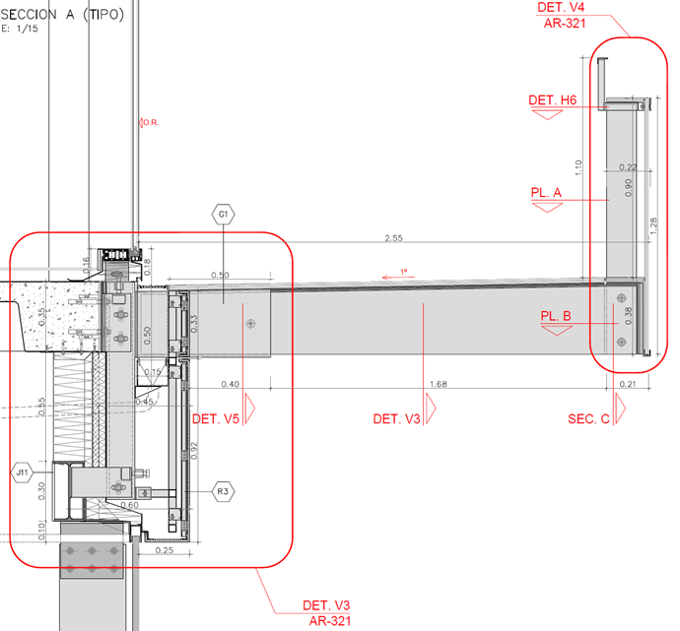
Main loads
Vertical Wind Load (Pressure) 1350 N/m2
Vertical Wind Load (Pressure) 1110 N/m2
Live Loads 800 N/m
Occupant Loads 5 kN/m

Slide 32
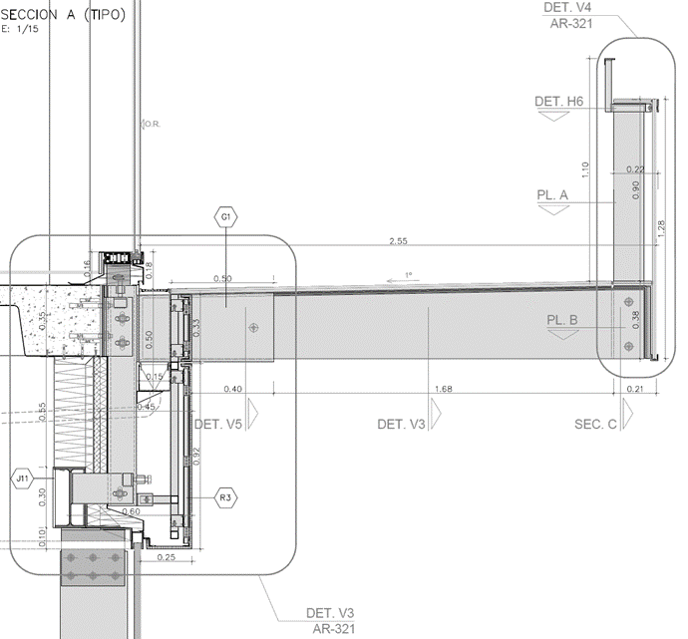
Main loads
Vertical Wind Load (Pressure) 1350 N/m2
Horizontal glass 60N
Vertical Wind Load (Pressure) 1110 N/m2
Vertical Cantilevered glass beam glass 87N
Horizontal glass 60N
Cantilevered glass beam 1125N
Vertical glass barrier 793N
Live Loads 800 N/m
Occupant Loads 5 kN/m
*Loads each 1.03m

Slide 33
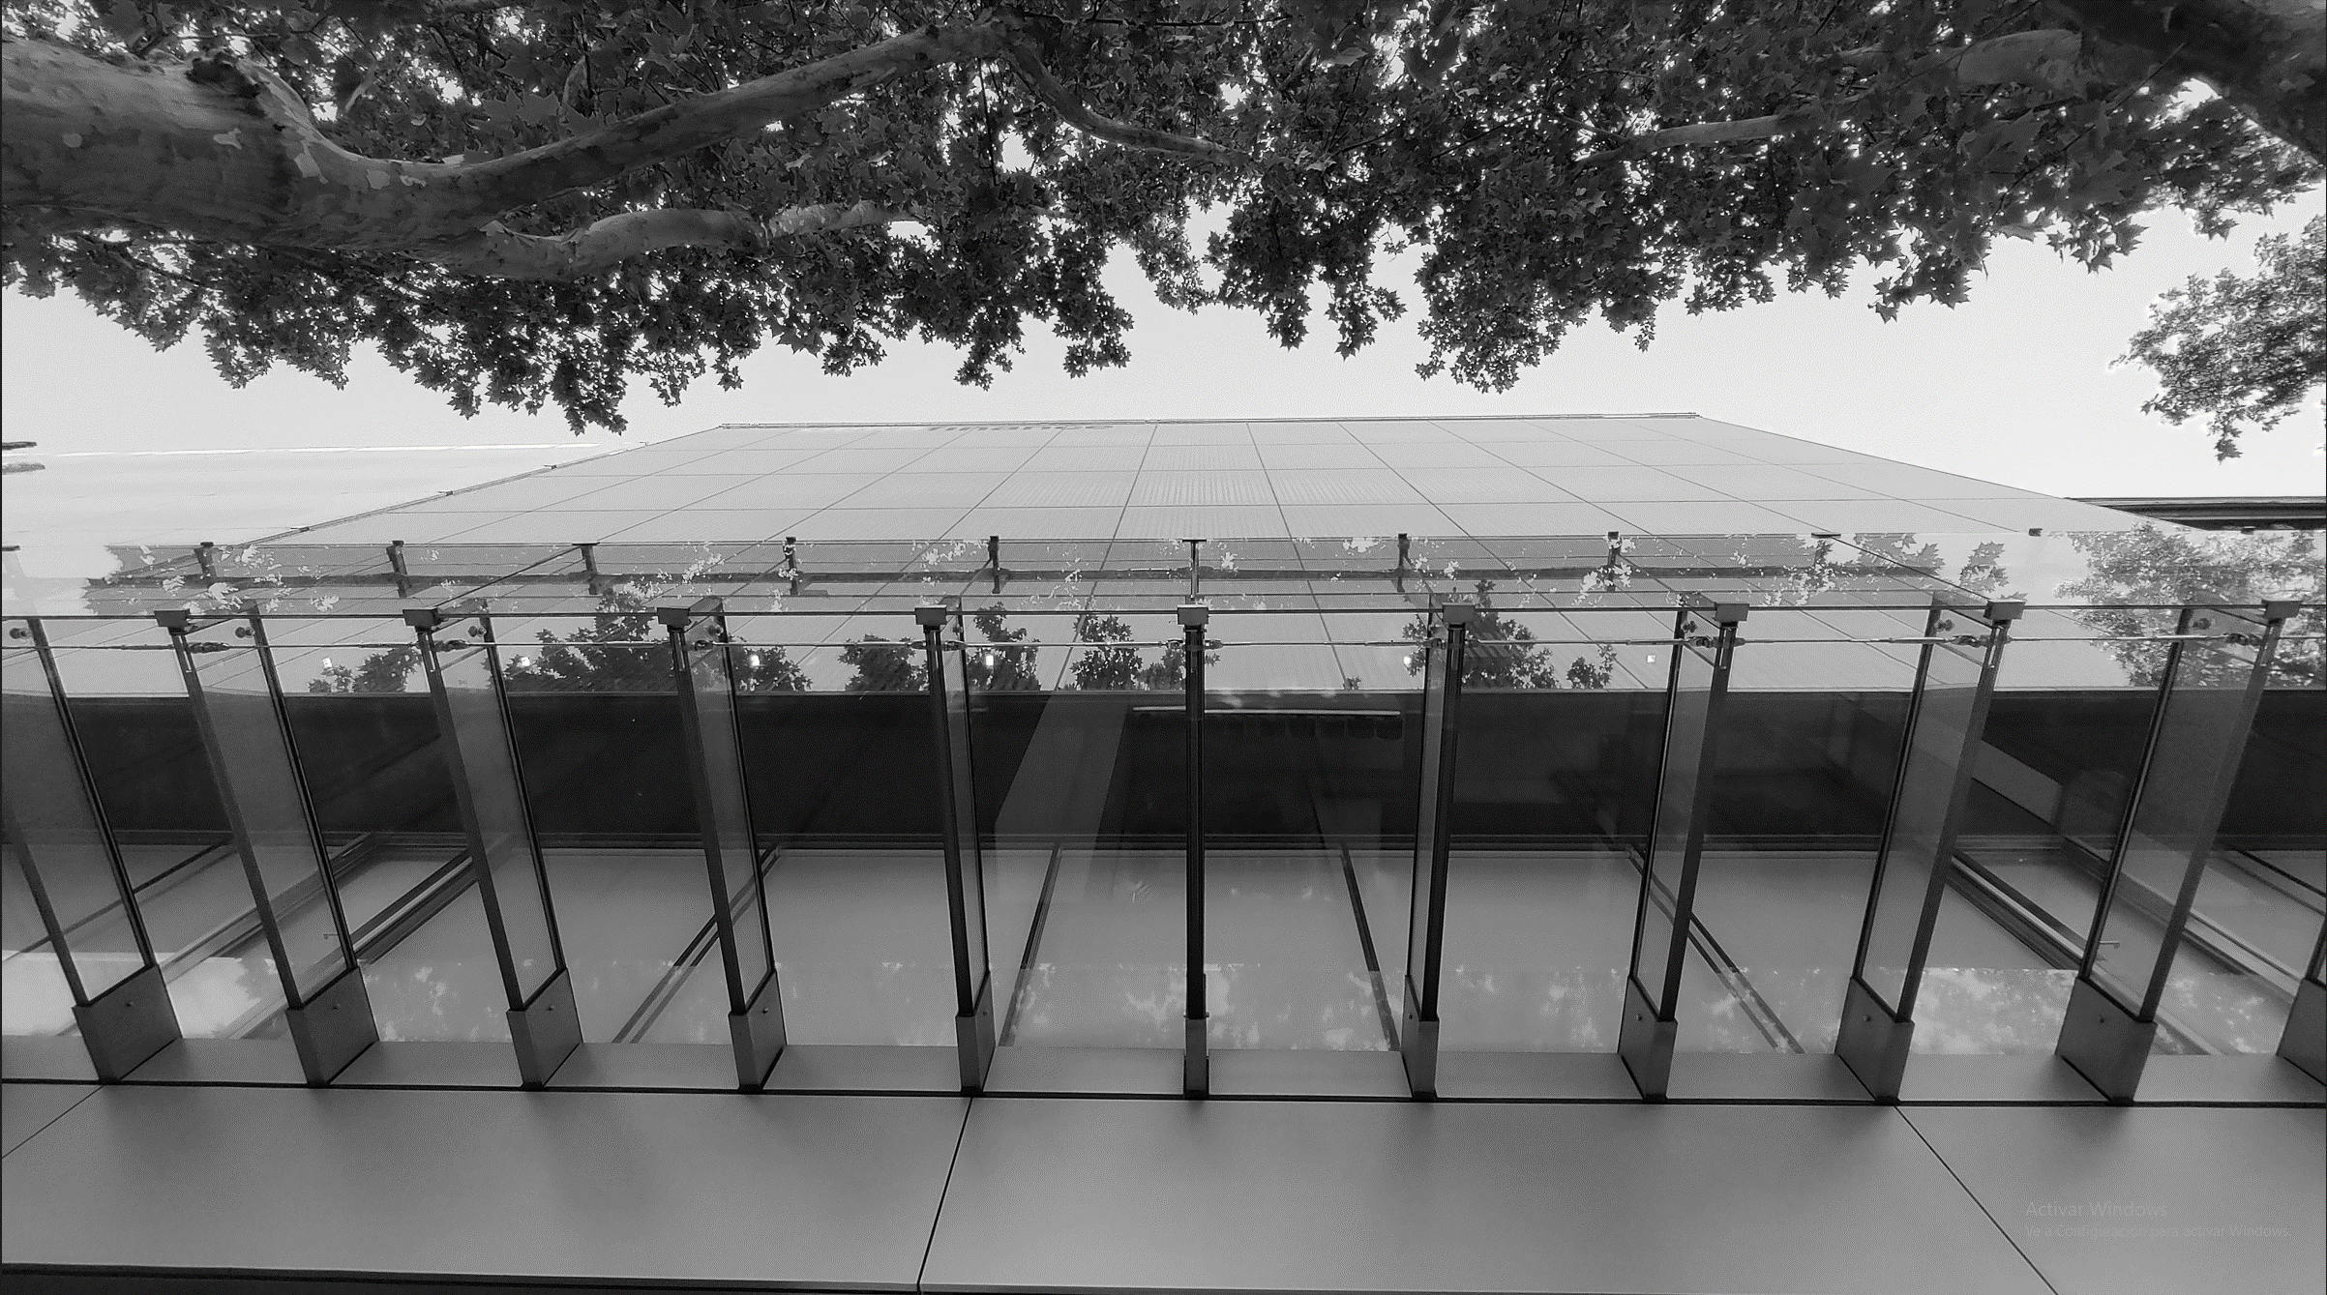
Develop of the details

Slide 34
10T + 1.52SGP + 10T+ 1.52SGP + 10T +1.52SGP + 10T + 1.52SGP + 10T + 1.52SGP + 10T

Slide 35
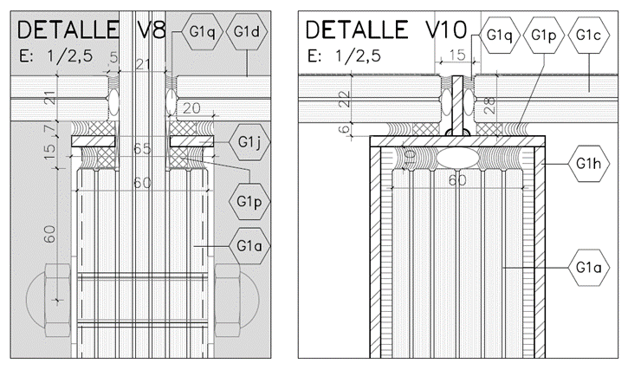
6T + 1.52SGP + 10HS + 1.52SGP + 10HS

Slide 36
6T + 1.52SGP + 6T + 1.52SGP + 6T

Slide 37
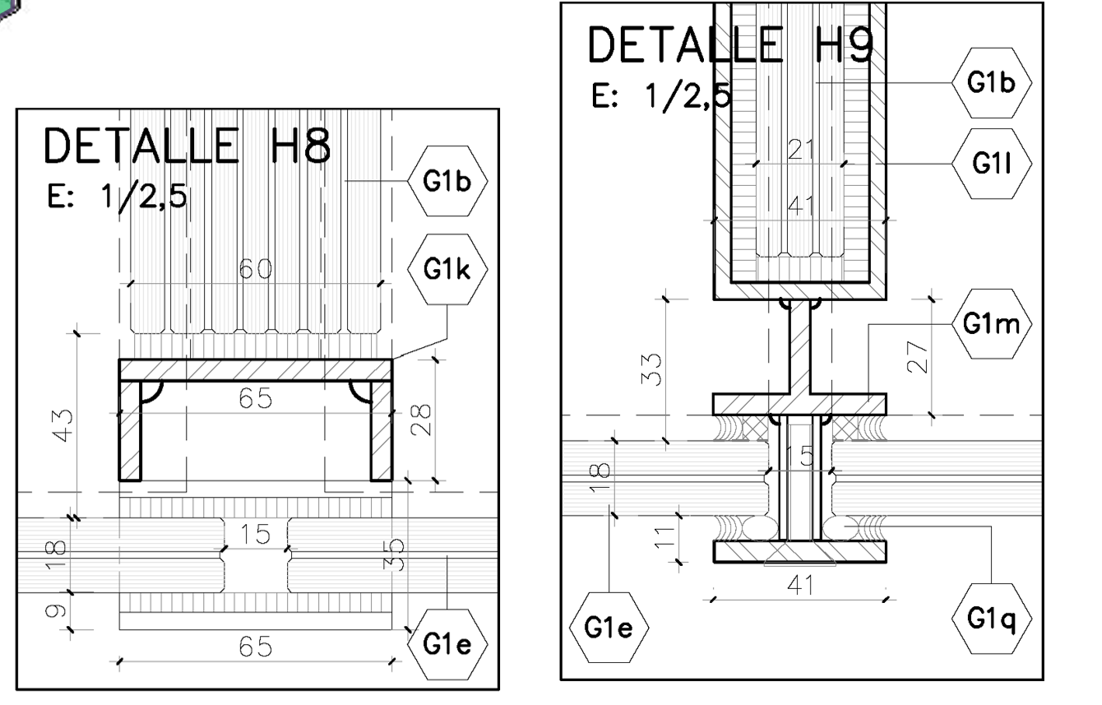
8HS + 1.52SGP + 8HS

Slide 38
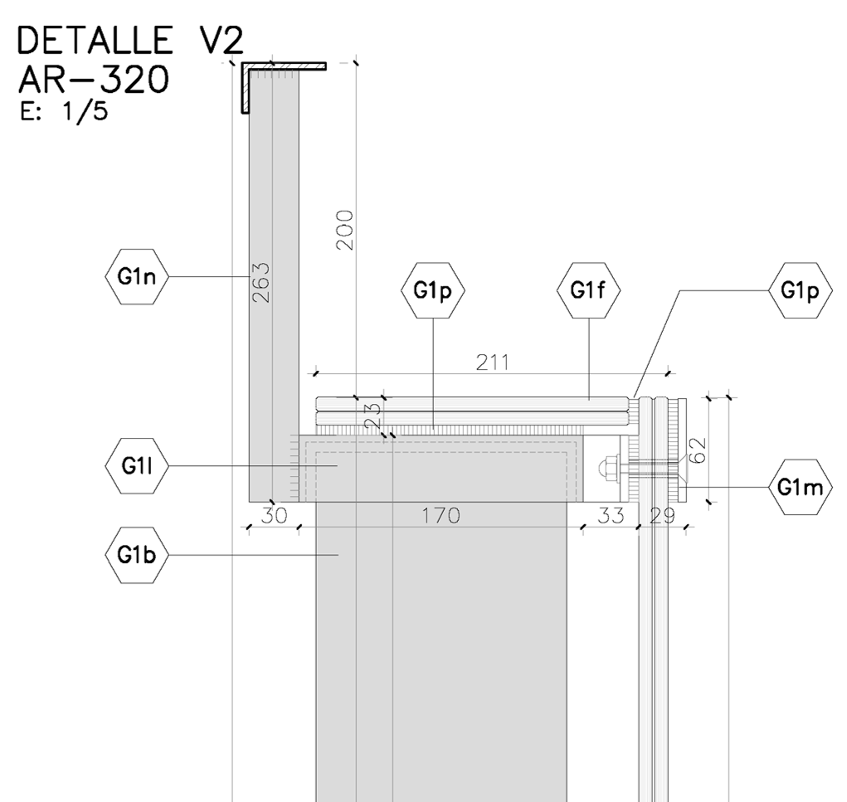

Slide 39
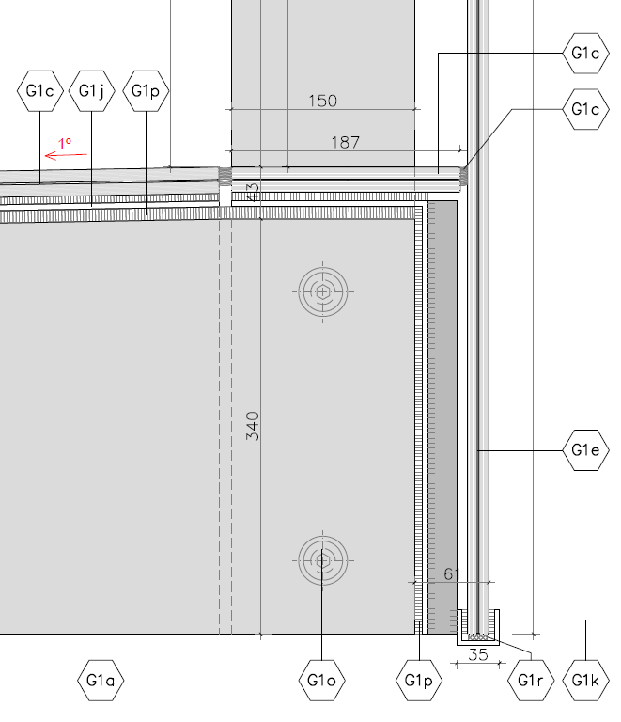

Slide 46
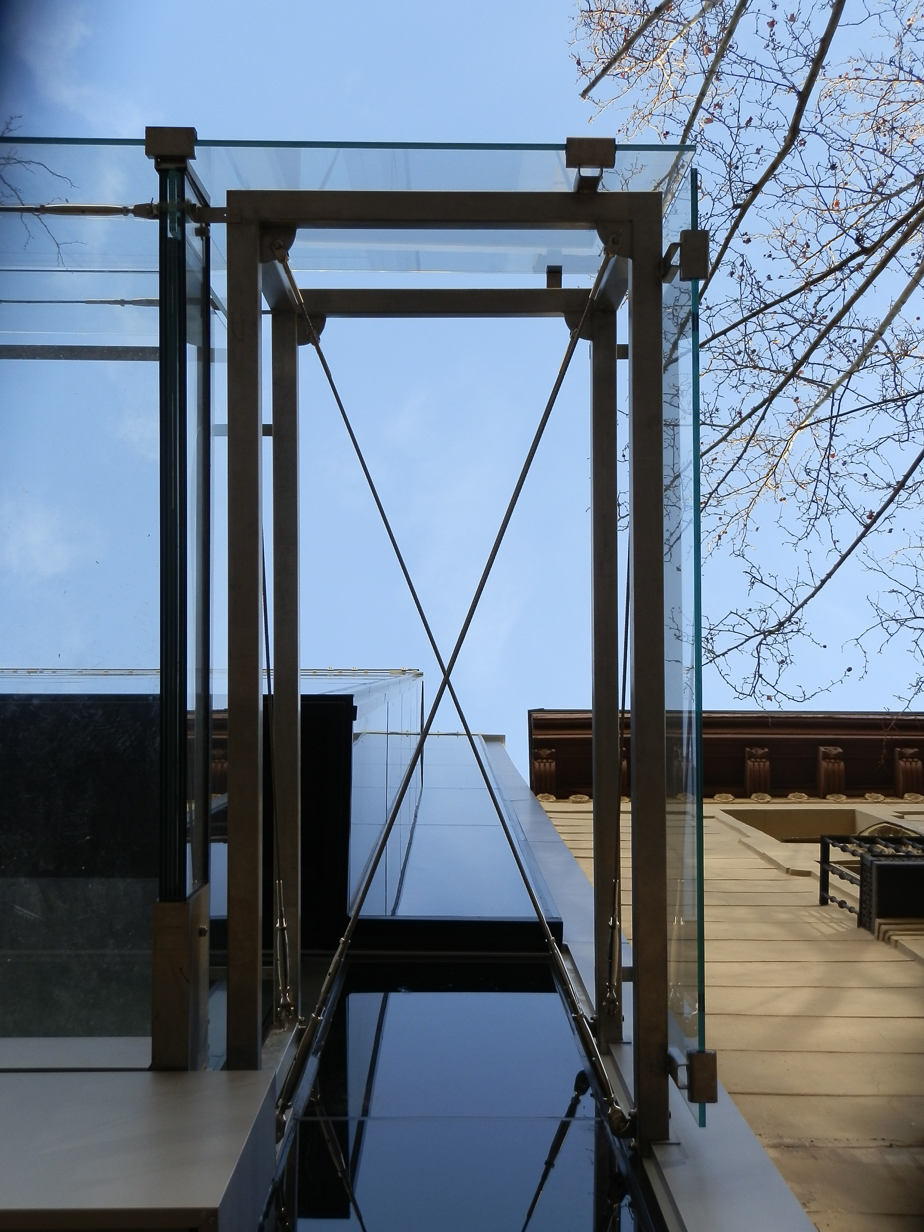

Slide 50
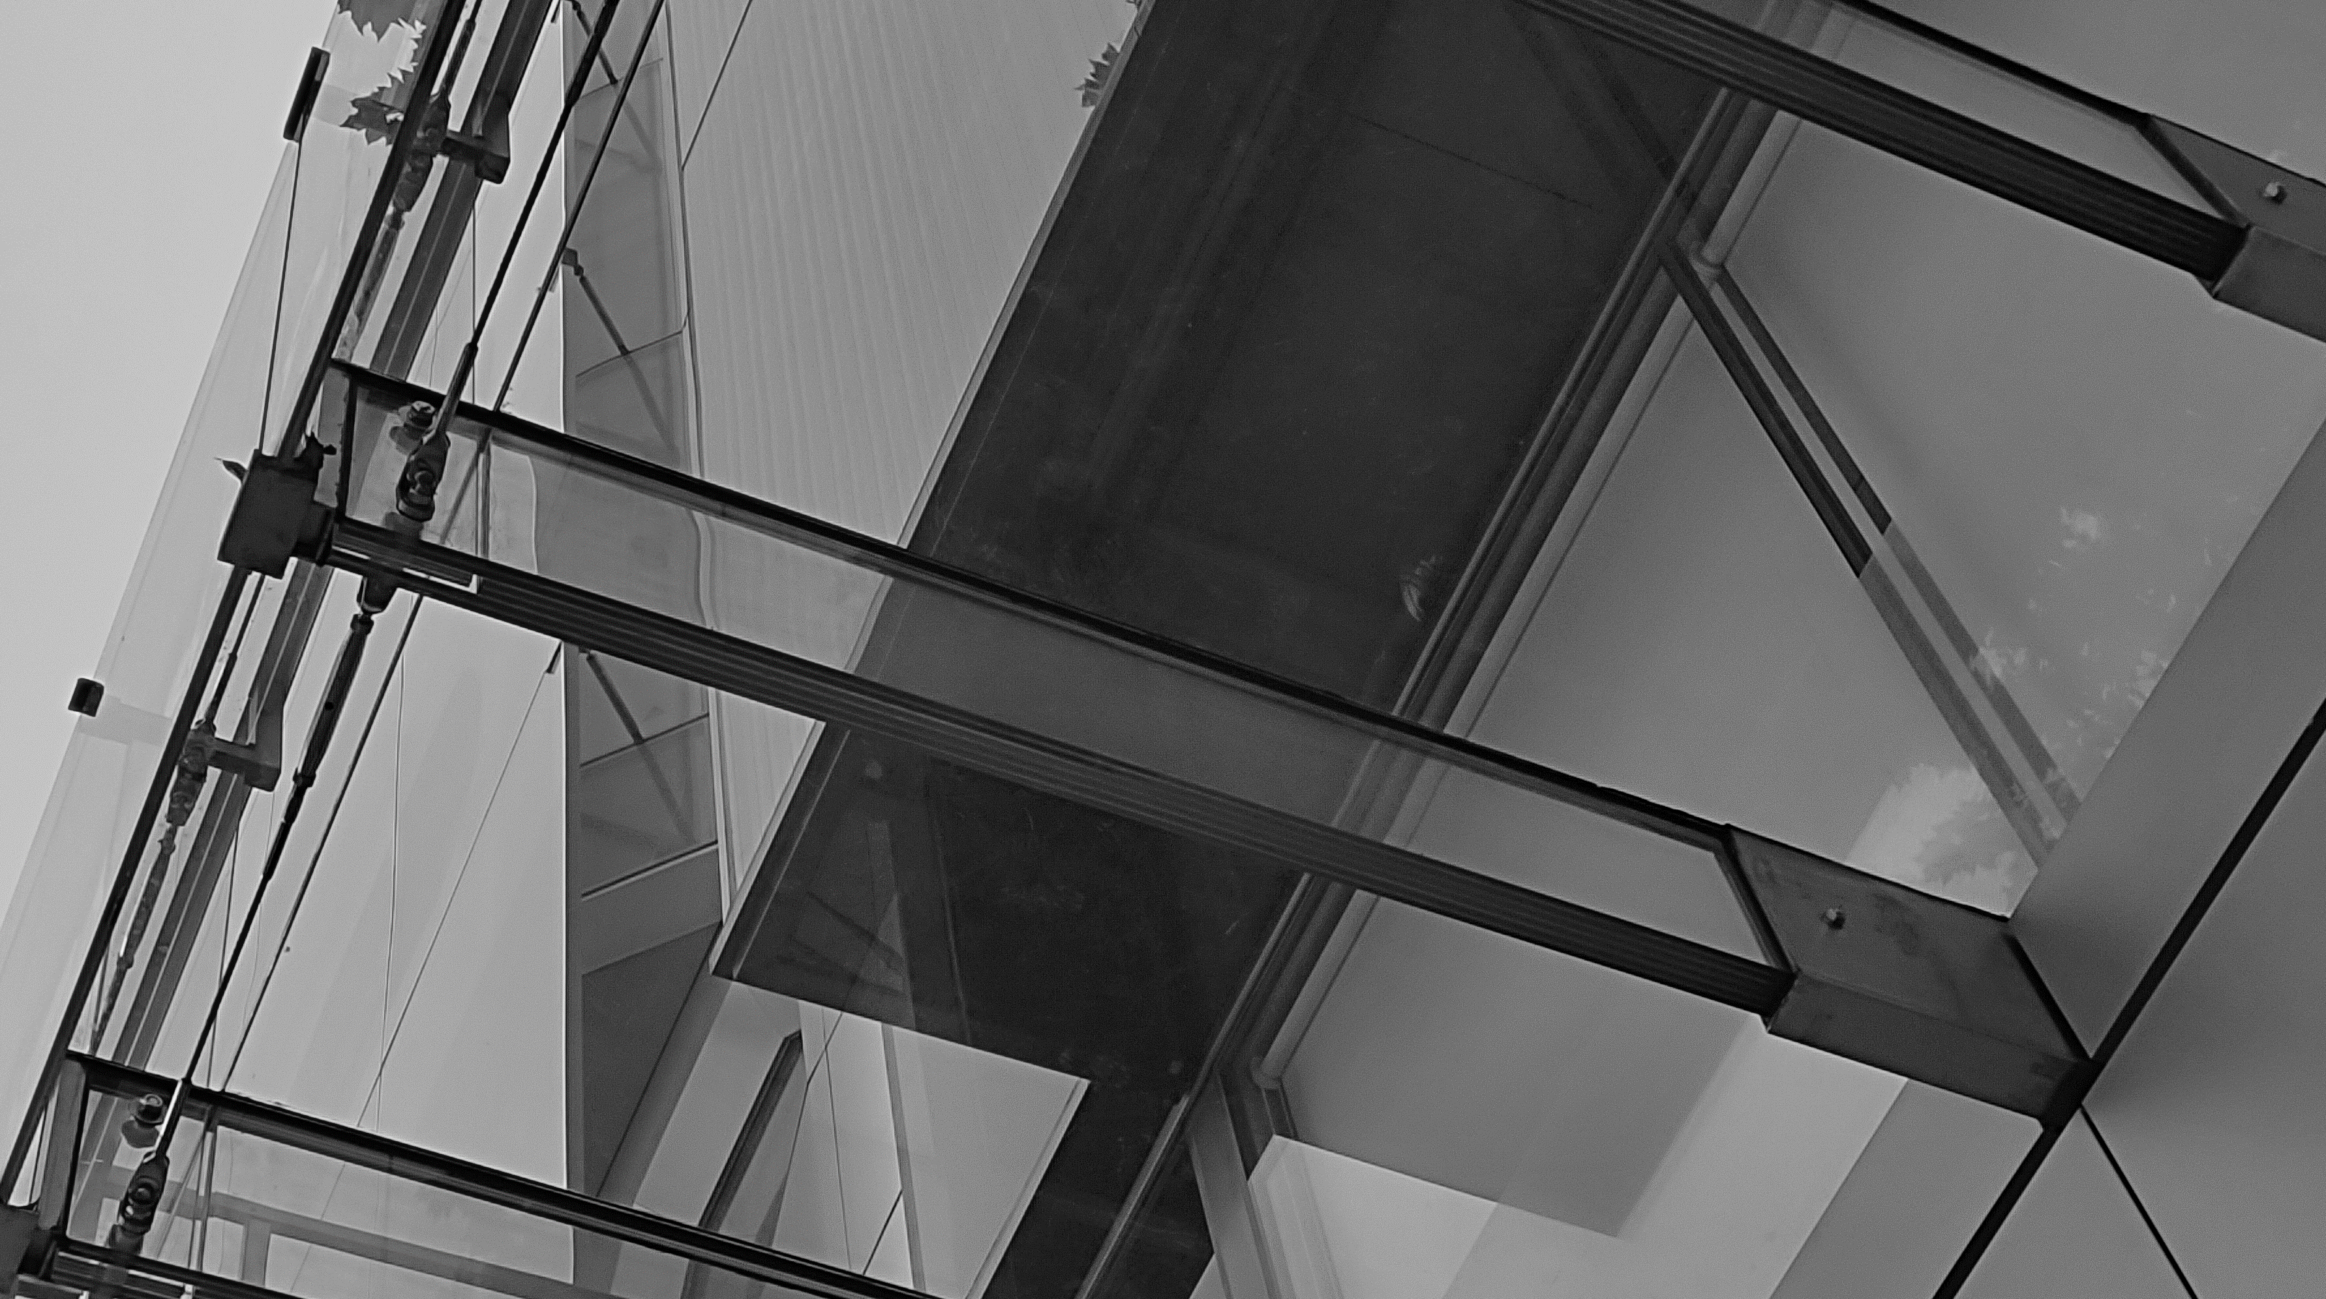
Photos of the elements

Slide 51
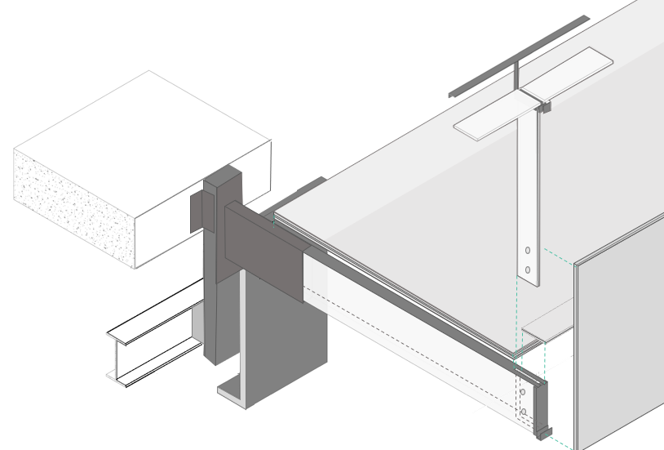

Slide 52
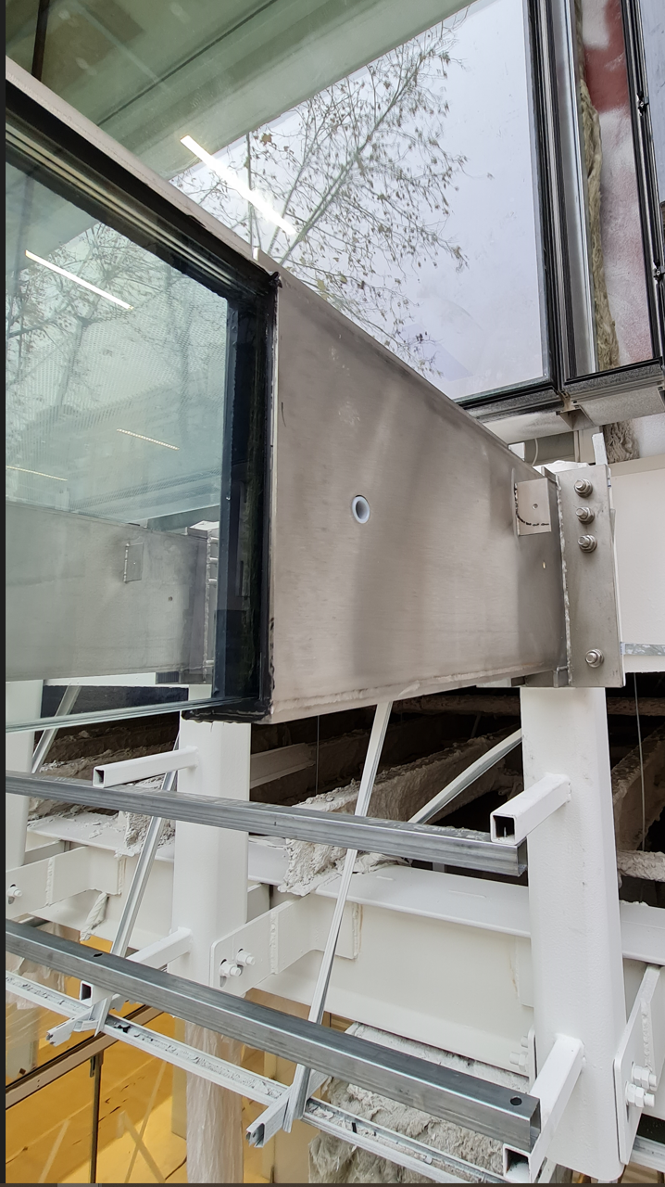

Slide 54
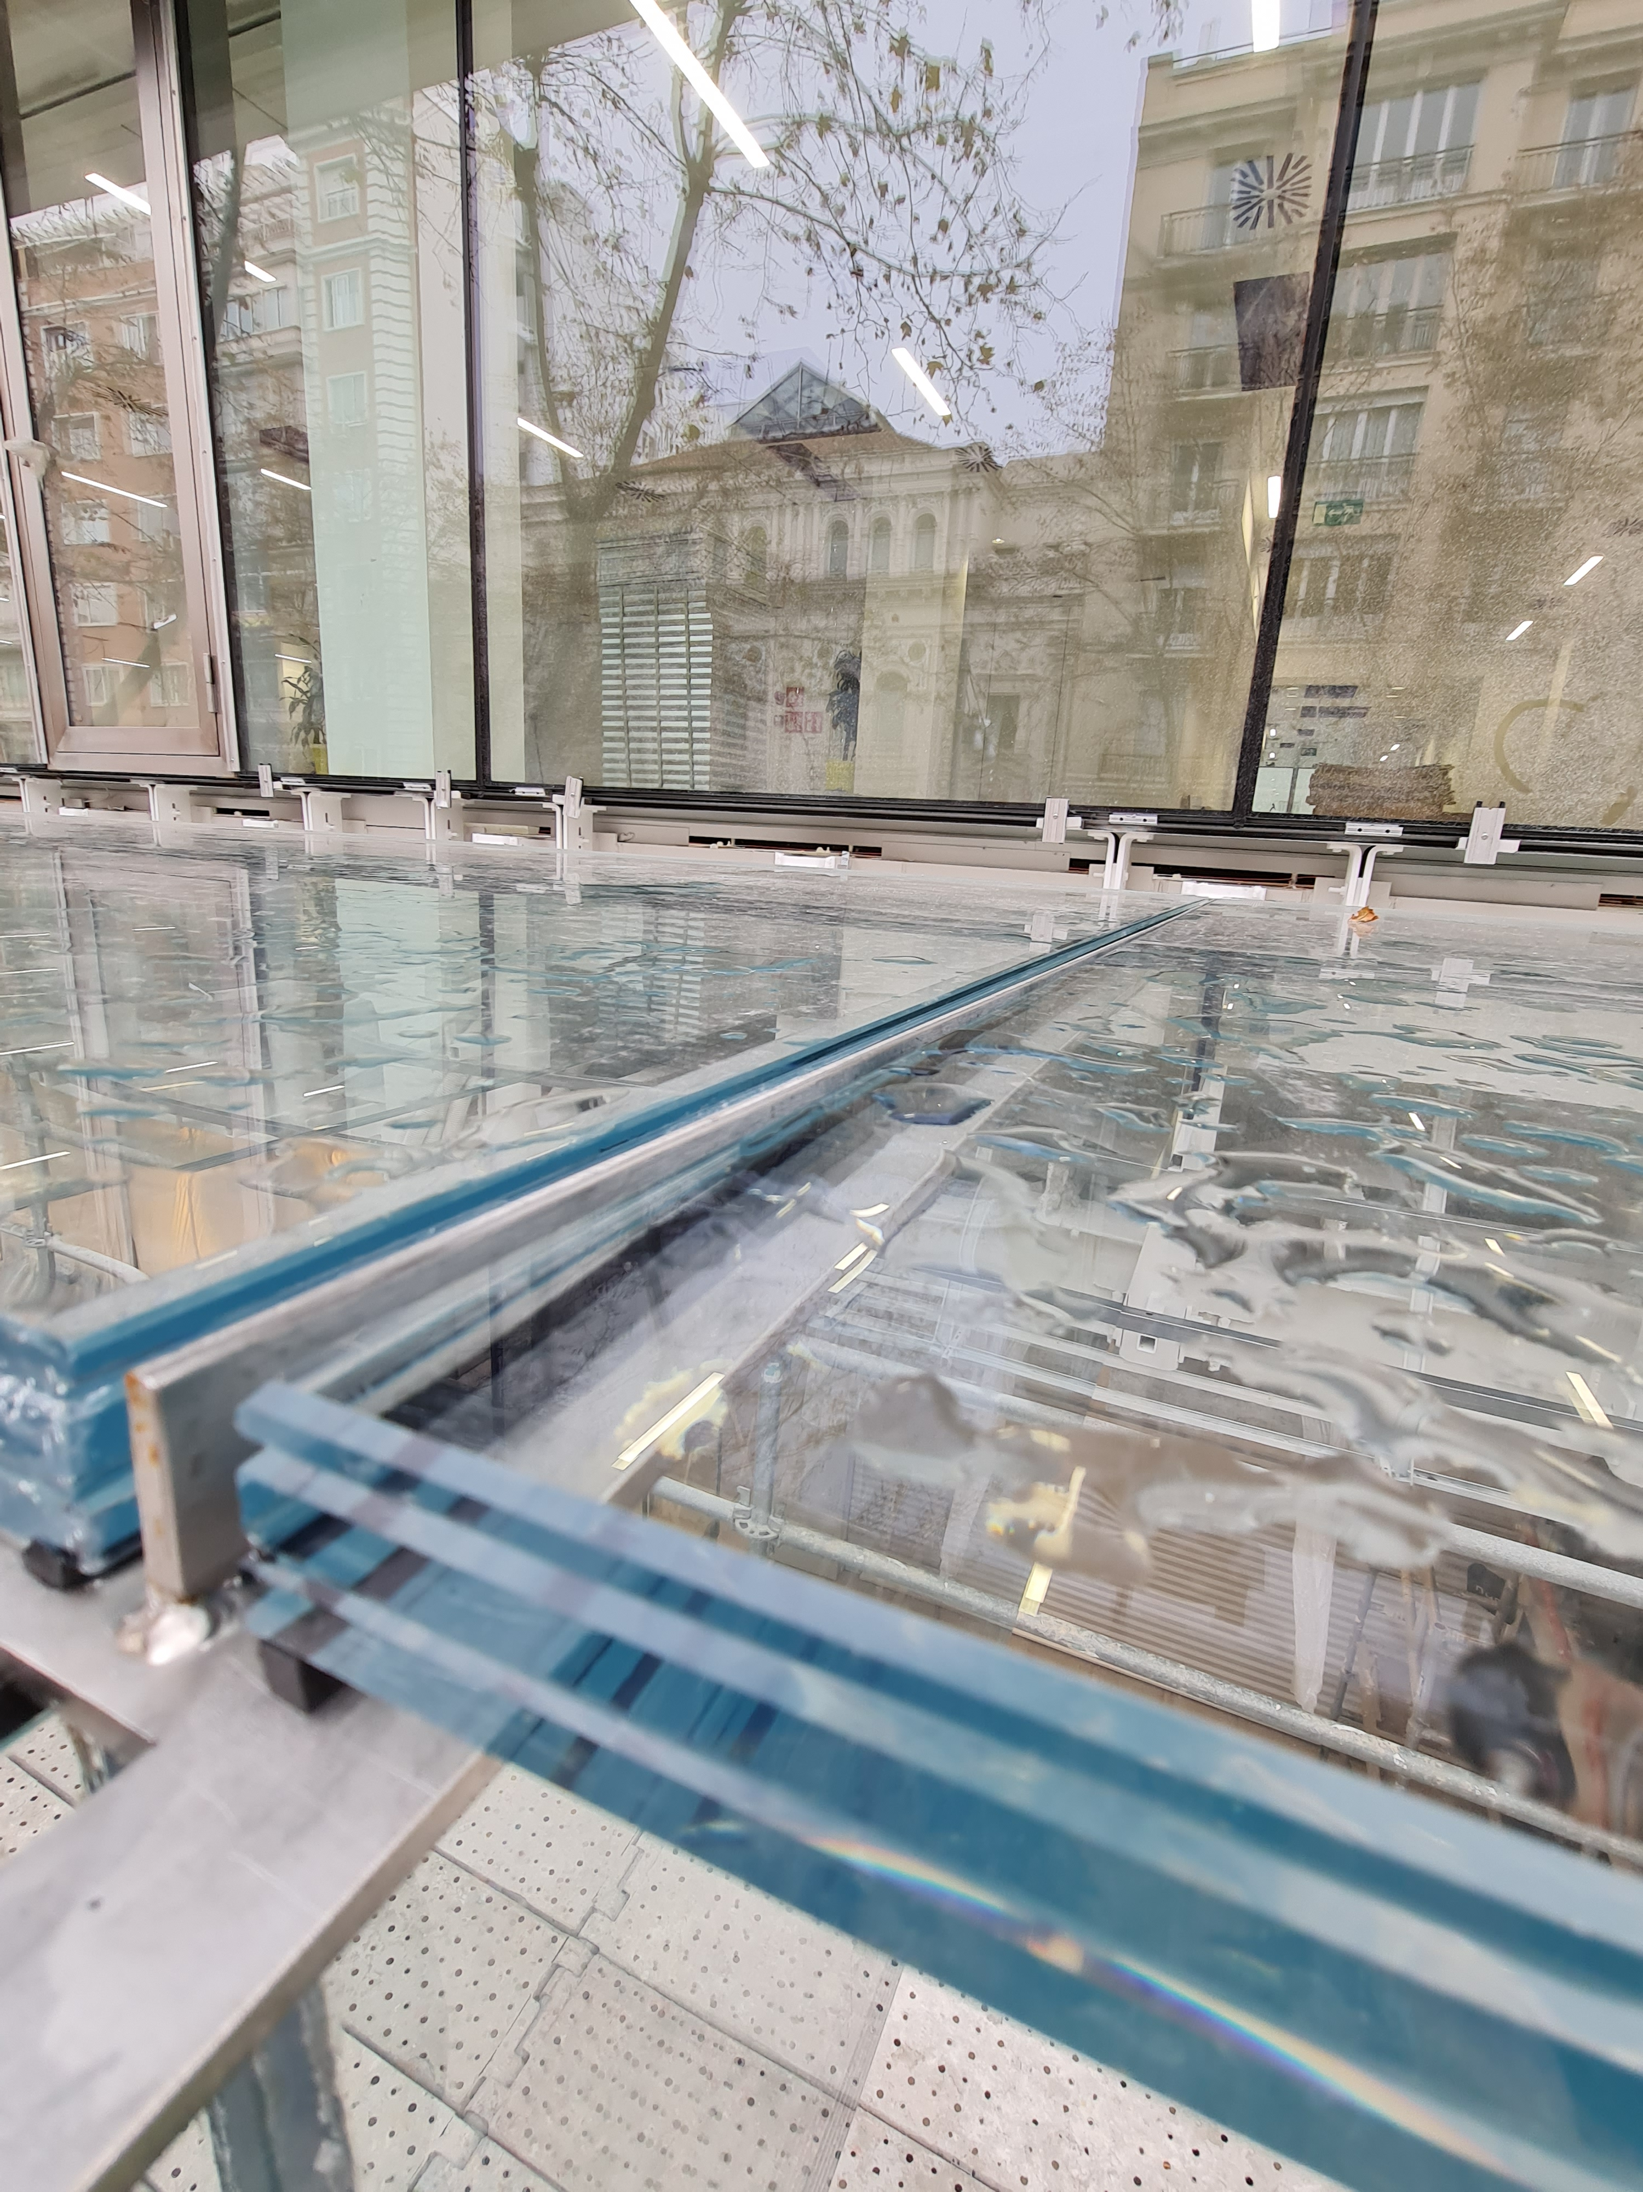

Slide 57
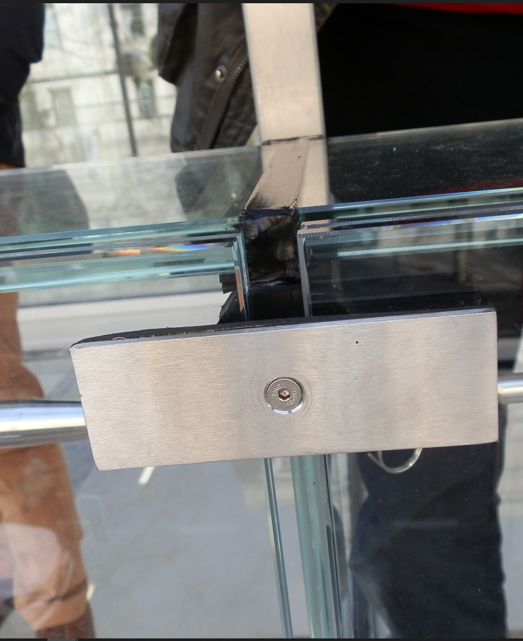

Slide 59
Conclusions

Slide 60
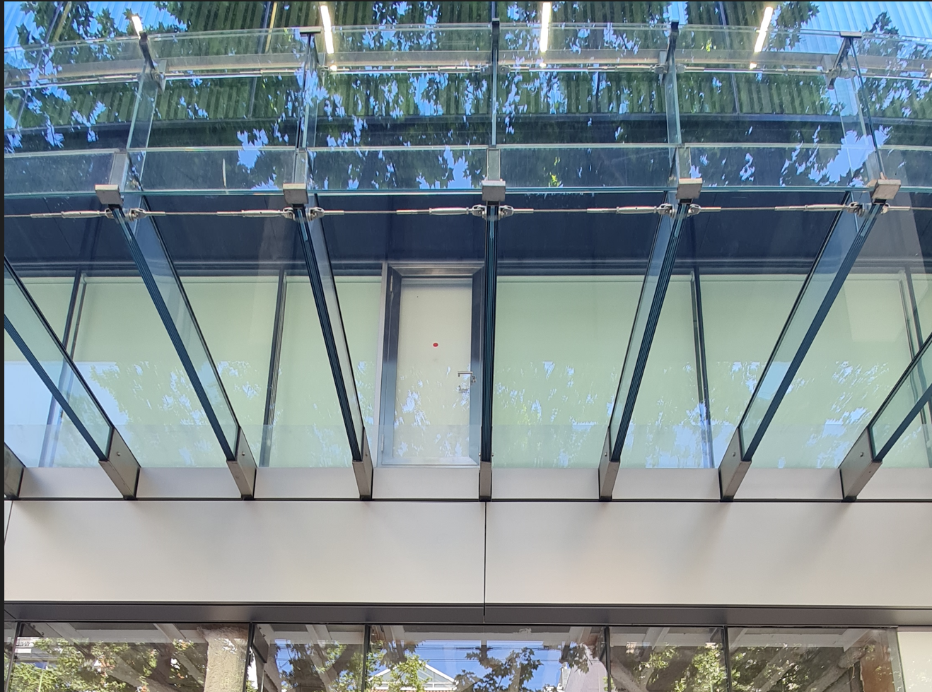
Notes:
In the skylight system , the glass beam is composed by a laminated glass of three panes of 12 mm tempered glass, with a stainless steel “T” profile glued in the top in order to support the horizontal glass of the skylight. The horizontal glass of the enclosure is composed by a double glazing. The exterior pane is a 8 mm exterior tempered glass with a solar control coating in face 2, and the interior pane is a laminated glass composed by two panes of 6 mm with 2 PVB. In between the two layers there is a gap with Argon to obtain a better thermal behaviour and to avoid the interior condensation.

Slide 61
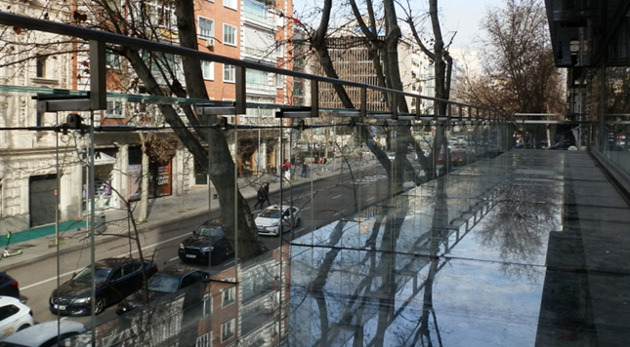
Notes:
In the skylight system , the glass beam is composed by a laminated glass of three panes of 12 mm tempered glass, with a stainless steel “T” profile glued in the top in order to support the horizontal glass of the skylight. The horizontal glass of the enclosure is composed by a double glazing. The exterior pane is a 8 mm exterior tempered glass with a solar control coating in face 2, and the interior pane is a laminated glass composed by two panes of 6 mm with 2 PVB. In between the two layers there is a gap with Argon to obtain a better thermal behaviour and to avoid the interior condensation.

Slide 63
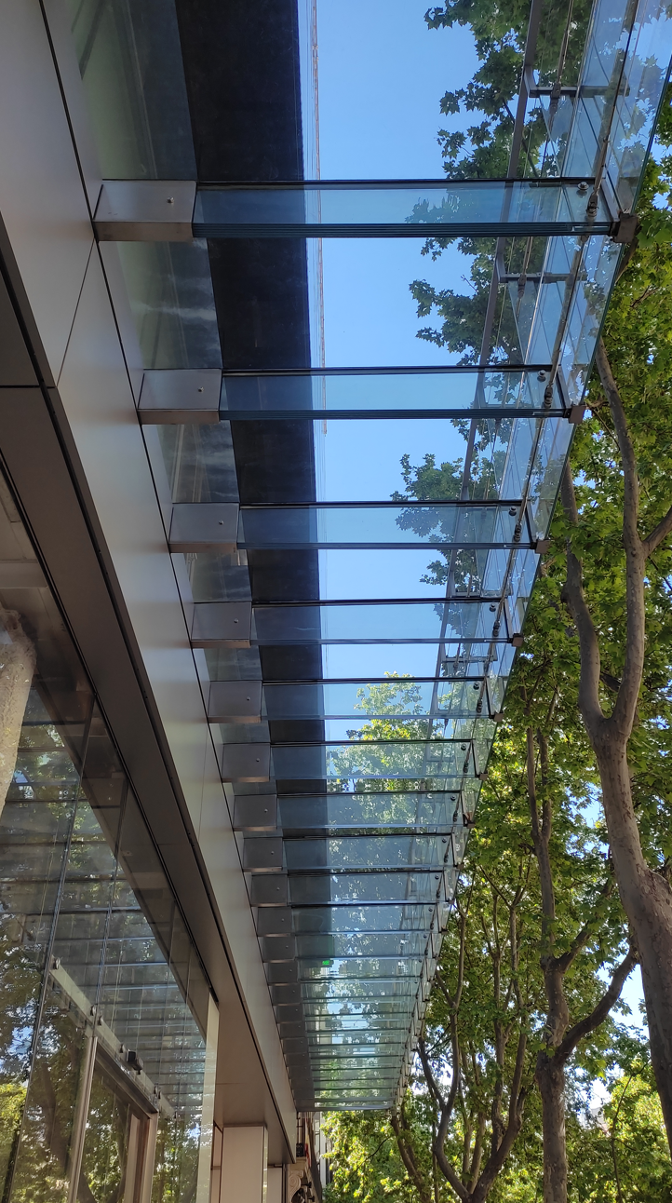
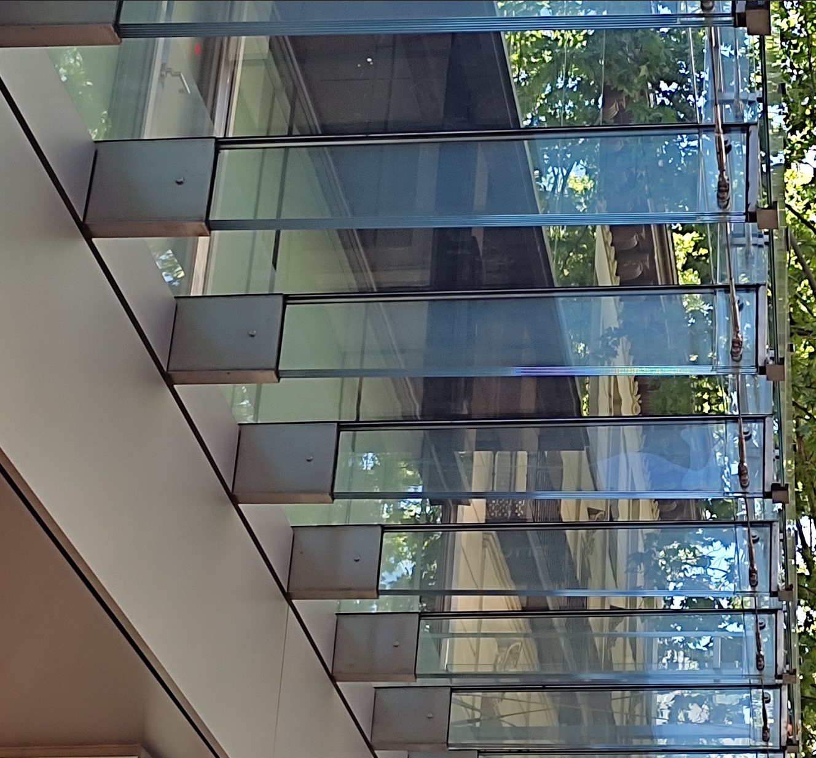

Slide 64
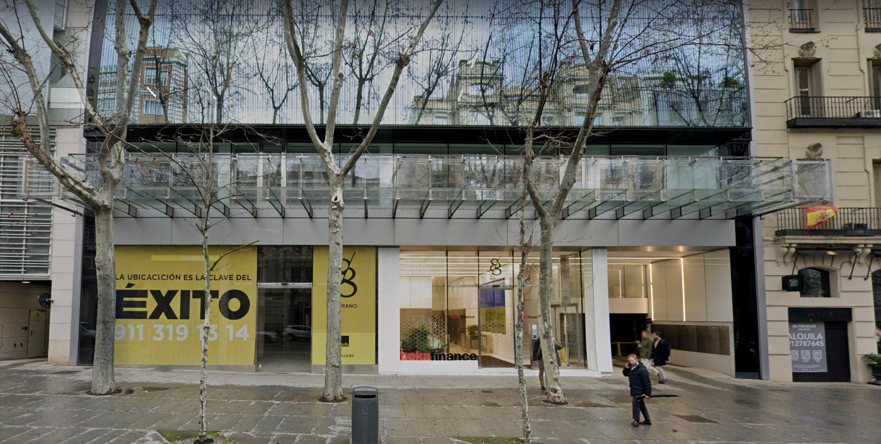

Slide 65
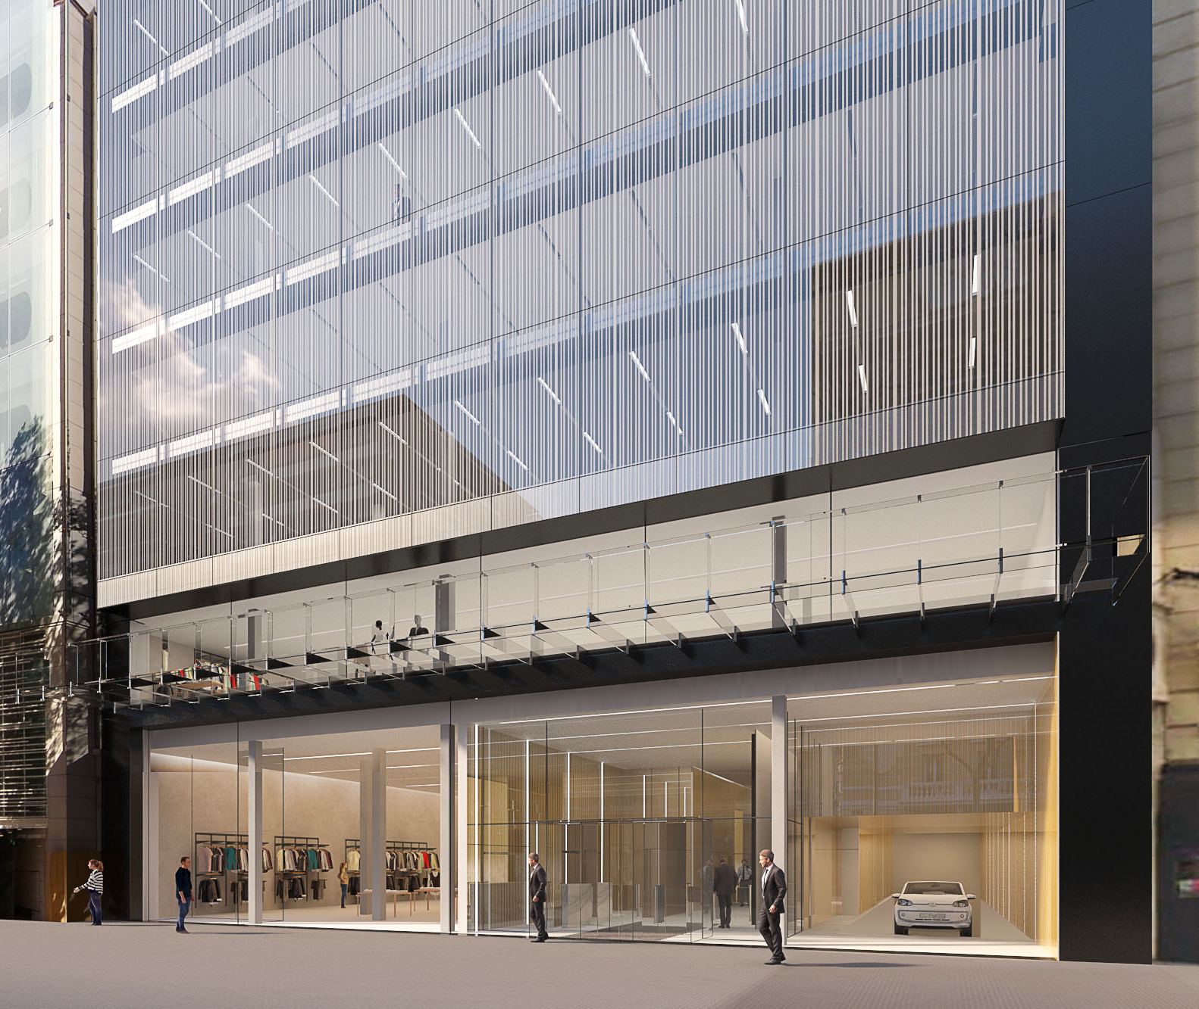
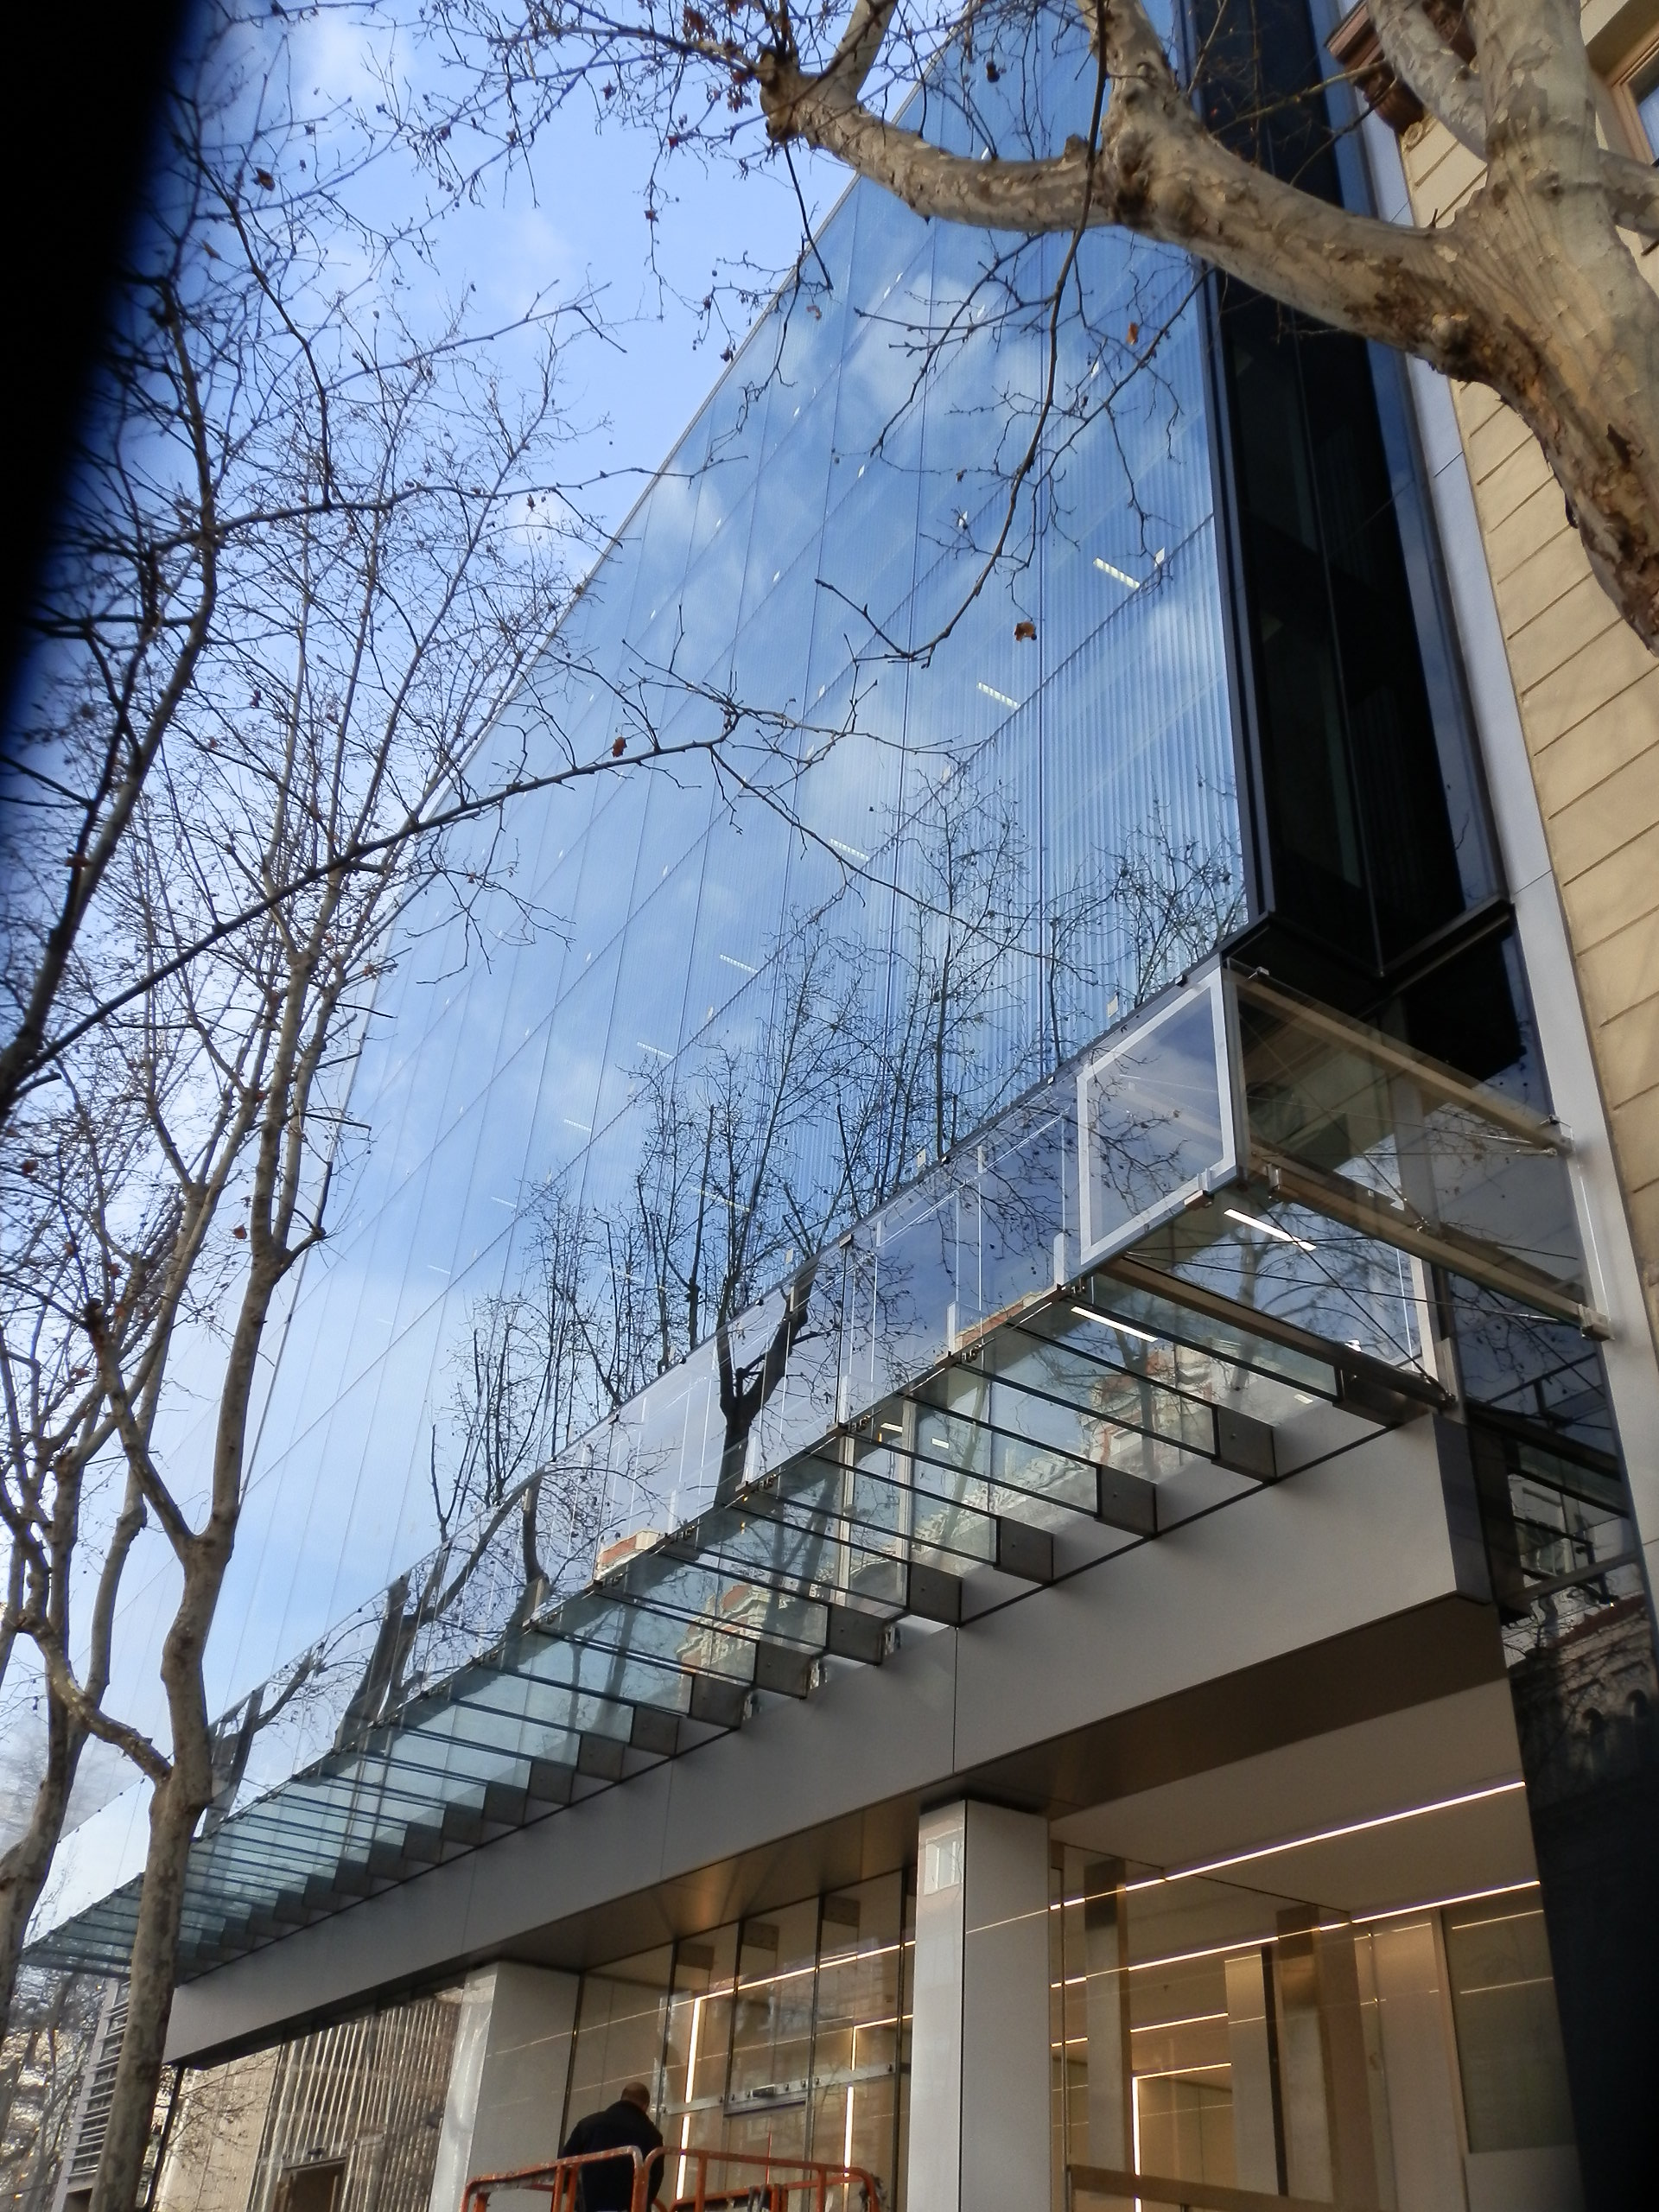

Slide 66
A. Mateo Marcos. Architect
ENAR SLP. Architectural Envelopes

